Slide 1
Engaging language educators: OER and staff development
Kate Borthwick
Centre for Languages, Linguistics and Area Studies
University of Southampton
‘Open Educational Resources in Languages,’ 1st June, 2012, UCLAN
LLAS
Centre for Languages, Linguistics and Area Studies University of Southampton
Southampton, SO17 1BJ +44 (0) 23 8059 6860 | @LLASCentre | www.llas.ac.uk

Slide 2
Overview
LLAS practitioner projects
Identified reasons for engaging with open practice
The FAVOR project – hourly paid tutors
Conclusion: engaging with open practice leads to a range of professional development opportunities

Slide 3
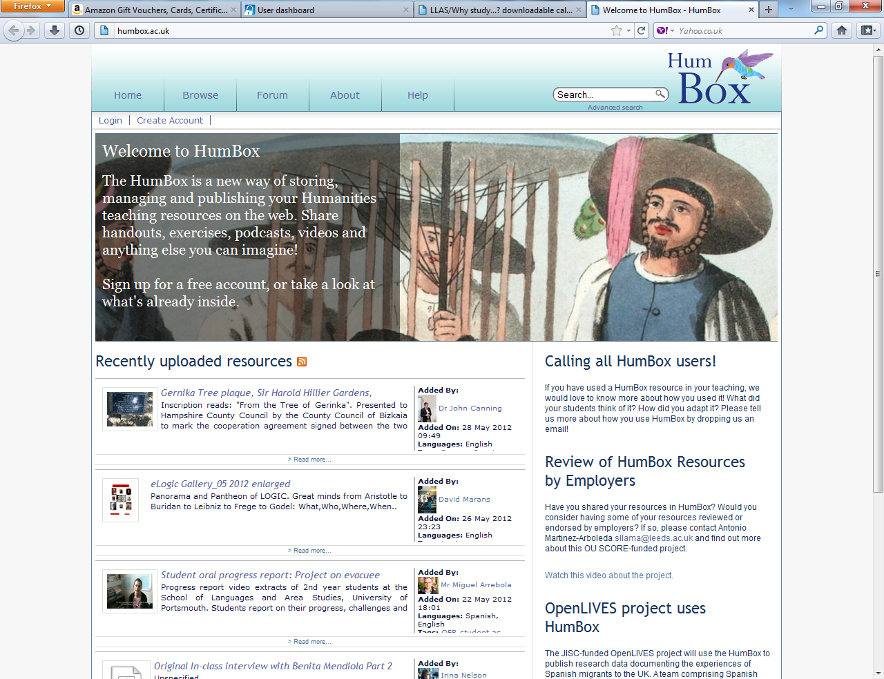

Slide 4
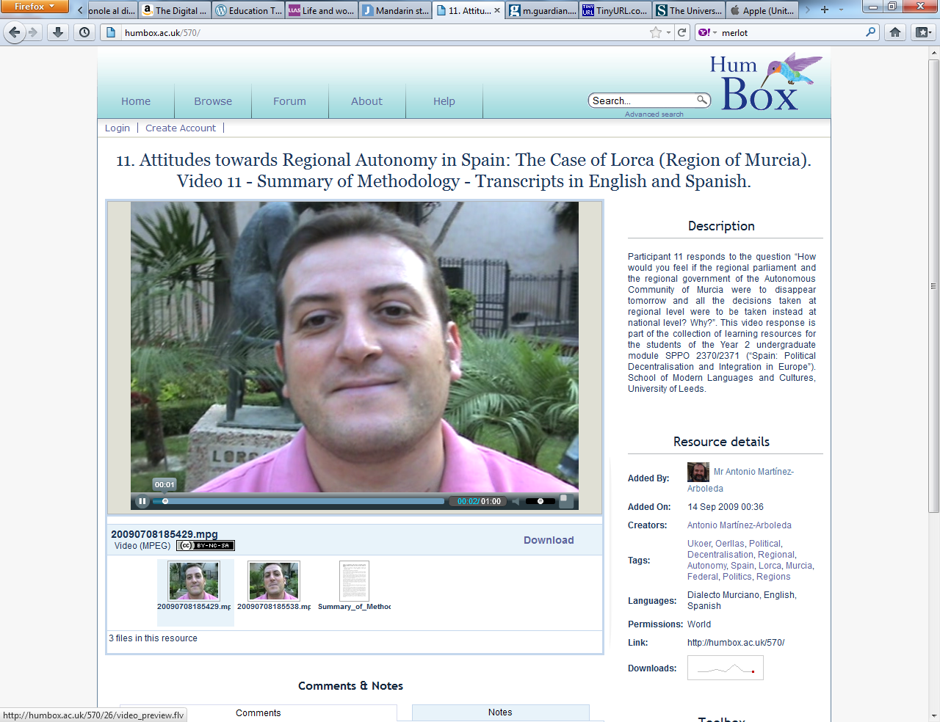

Slide 5
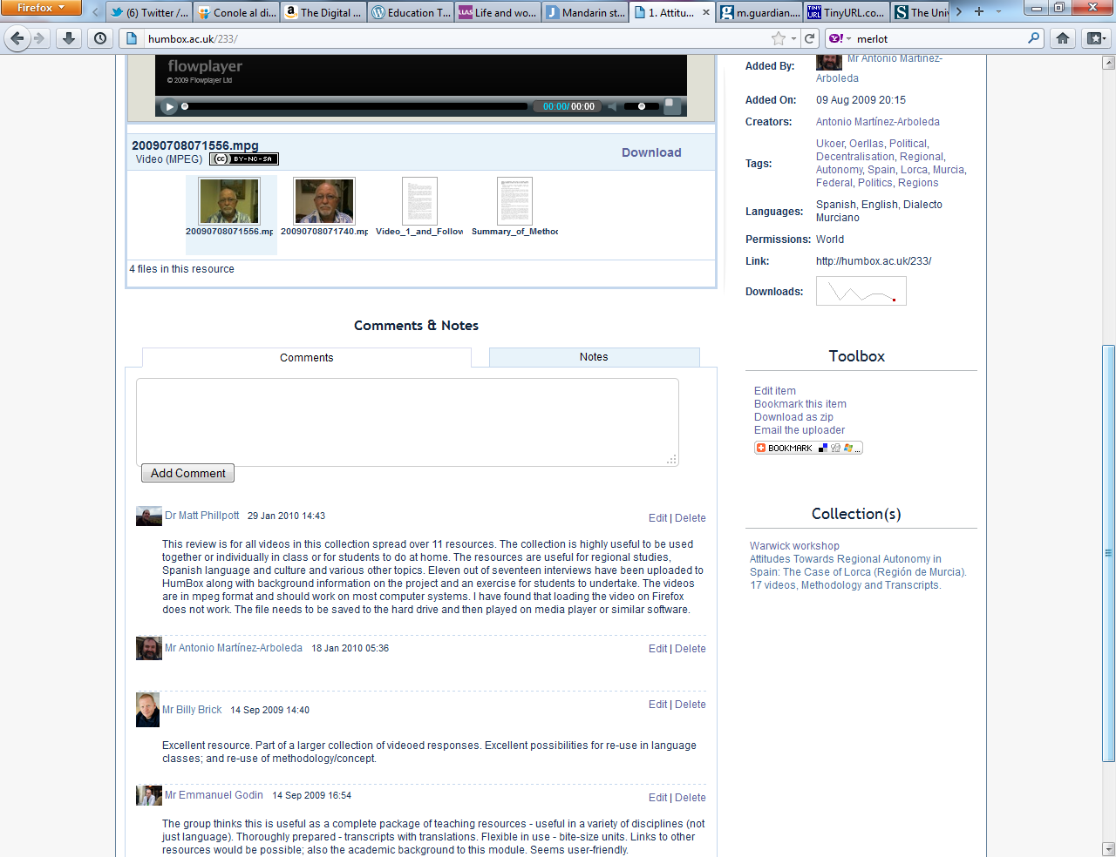

Slide 6
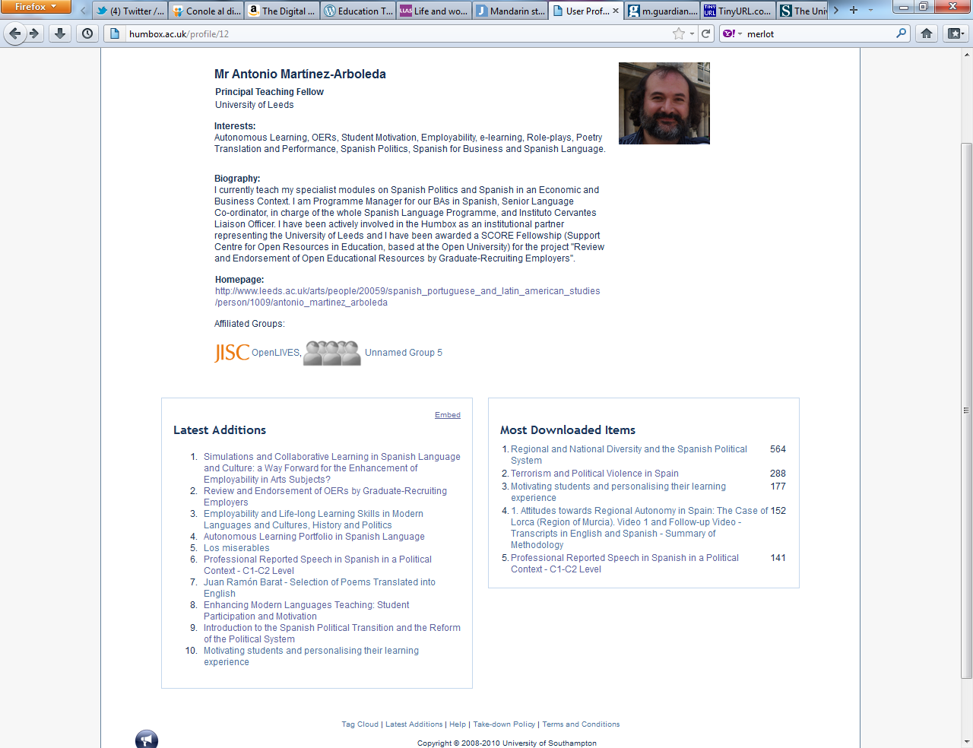

Slide 7
Benefits of sharing for professional development
Way of showing impact:-
for non-research active staff
demonstrating excellence in teaching
raising your public professional profile
linking research and teaching
demonstrating excellence in content, technology or pedagogy
Practice: -
a way of making connections in discipline community
improves digital literacy
a way of making contact with other audiences for your work
encourages collaborative working

Slide 8
Why do people use the site?
see what other practitioners/institutions are doing
to share practice and get reviews
can find useful resources to adapt
helps to reflect on own practice
provides good ideas to improve/enhance practice
good way to keep up with developments in the discipline
early career researchers can showcase work and teaching experience
can see perspectives from other hums disciplines
enables teaching to have a public dimension

Slide 9
The FAVOR project
Finding A Voice through Open Resources (JISC)
Part-time, hourly-paid language tutors
Sharing existing resources
Creating new transition resources for prospective university applicants: ‘taste of’ new languages; language study at HE
Collaboration: Southampton, SOAS, UCL SSEES, Aston, Newcastle

Slide 10
Issues for hourly-paid tutors
Often unrecognised and undervalued
Employed in ‘Language Centres’ separate from academic depts
Teaching-only contracts (Coleman, J, 2004)
“…could be forgiven for feeling like second-class citizens,” Klapper, J. (2006)
Intensive teaching schedules
Lack of opportunity to engage with academic life and professional development opportunities

Slide 11
Benefits of open practice
Can demonstrate impact to institution as well as beyond
Colleagues who work cross-sector, cross-institution can bring work together under one online profile
Facilitates networking locally and beyond
Creating new, high quality OERs will raise profiles of creators
Enhances digital literacy and professional practice

Slide 12
Concluding remarks
Open practice is potentially a good vehicle for professional development in a range of ways, from profile-raising; encouraging reflection on current practice, to enhancing digital literacy
Enhanced usefulness if part of a community of collegiate ‘sharers’
Benefits for full engagement (sharing your work and downloading) and for partial (browsing, downloading others’ work)

Slide 13
Useful links for info and advice (OERs)
OER Infokit: http://bit.ly/oerinfokit
The JISC (funding, OER projects): www.jisc.ac.uk
Open Courseware Consortium: www.ocwconsortium.org
Some repositories:
Jorum: www.jorum.ac.uk
HumBox: www.humbox.ac.uk
LanguageBox: http://languagebox.ac.uk
LORO (Language Open Resources Online): http://loro.open.ac.uk/

Slide 14
Useful links: landscape for languages
Coleman, J. 2004, Modern Languages in British universities: past and present, Arts and Humanities in Higher Education, 3(2), 147–162.
Klapper, J. 2006, Understanding and Developing Good Practice: Language Teaching in Higher Education. London: CILT.
Howarth, P. 2011, Language Centres and Academic Departments. Available online: http://www.ucml.ac.uk/shapingthefuture/identity
Review of Modern Foreign Languages provision in higher education in England, HEFCE, by M. Worton: http://www.hefce.ac.uk/pubs/hefce/2009/09_41/

Slide 15
Thank you, questions, discussion!
Do you think new academic/teaching staff should be actively encouraged to engage with open practice?
What other things do we need to do to engage more staff with open practice?
Do you think that engagement with open practice should be made part of the REF/promotion pathways?

