Slide 1
The OpenLIVES project: Pedagogical Developments @ Leeds
Antonio Martínez-Arboleda
University of Leeds
OpenLIVES HEA Workshop
University of Southampton – LLAS
23 May 2012

Slide 2
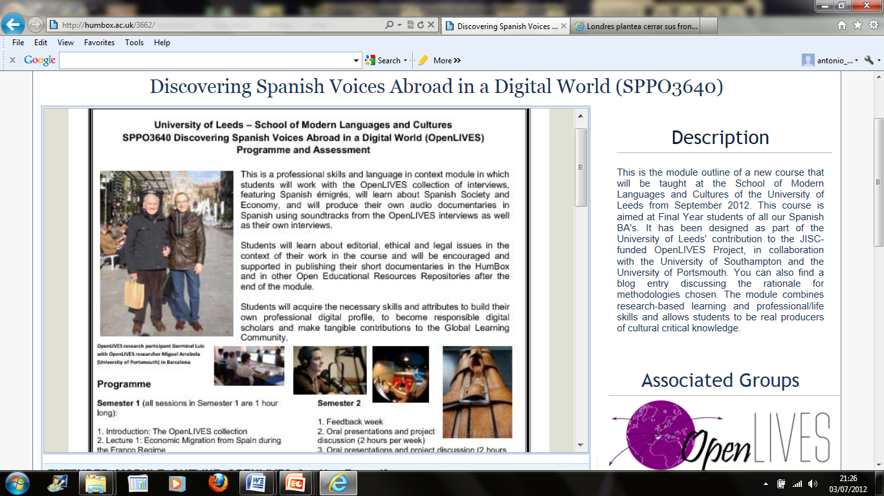
OpenLIVES module @ Leeds

Slide 3
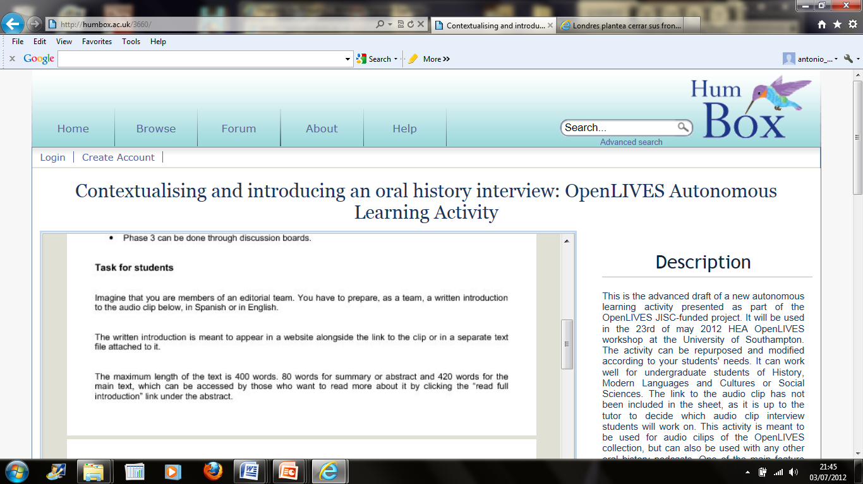
OpenLIVES Autonomous Learning

Slide 4
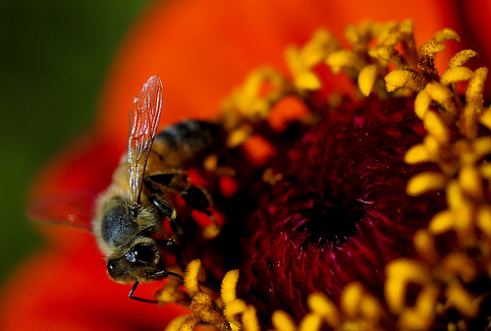
OpenLIVES Organic Pedagogy
Social,
Meaningful,
Integral,
Trans-academic,
Collaborative,
Ethical,
and Personalised Learning
-Chris Willis , Flickr CC BY

Slide 5
OpenLIVES Organic Pedagogy
Socially and personally relevant student outputs: Digital profile, socially and personally meaningful, engaging. From pupil student to researcher, producer (Mike Neary) and public author.
2. Full-cycle complex student production process
From the fields to the table
3. Trans-academic life skills
Academic Skills transferred to professional/life contexts within an educational environment – transferring skills
‘Transferring skills’: higher order skills that enable the person ‘to select, adapt, adjust and apply [his or her] other skills to different situations, across different social contexts and perhaps similarly across different cognitive domains’ (Bridges, 1993, p.50).

Slide 6
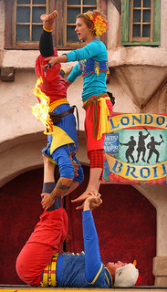
OpenLIVES Organic Pedagogy
4. Socially constructed knowledge
5. Research-based graded learning
M. Healey + RSD of the University of Adelaide
7 Ethically produced knowledge
8. Flexible and personalised learning
Alaska_Dude, Flickr, CC BY

Slide 7
External references of work mentioned today
Student as Producer: http://studentasproducer.lincoln.ac.uk/ (Mike Neary) (last accessed 5 July 2012)
Jenkins A, Healey M and Zetter R, Linking teaching and research in departments and disciplines York: The Higher Education Academy 2007 http://www.heacademy.ac.uk/assets/documents/teachingandresearch/LinkingTeachingAndResearch_April07.pdf (last accessed 5 July 2012)
Yorke, M. Employability in higher education: what it is – what it is not The Higher Education Academy Learning and Employability Series. 2006. http://www.heacademy.ac.uk/assets/documents/employability/id116_employability_in_higher_education_336.pdf (last accessed 5 July 2012)
Ehiyazaryan, E. & Barraclough, N. (2009). Integrating real world experience in the curriculum: enhancing learners' employability. Education & Training Journal, 51(4), pp. 292-308.
http://www.adelaide.edu.au/rsd/framework/ (last accessed 5 July 2012)

