Slide 1
Exploring the relationship between linguistic knowledge, speech processing and oral fluency
Dr Zöe Handley, University of York
Dr Sible Andringa, Universität van Amsterdam
BAAL Annual Meeting 2015, Aston University

Slide 2
Research questions and definition of terms
Research questions
What are the components of oral fluency?
Definition of terms
Oral fluency: “the flow and smoothness of speech”
(Bosker et al., 2013, p. 2)
Cognitive fluency: “efficiency of the operation of the underlying processes”
Utterance fluency: “the features of utterances that reflect cognitive fluency”
Perceived fluency: “the inferences listeners make about … cognitive fluency based on their perceptions of utterance fluency”
(Segalowitz, 2010, p. 165)

Slide 3
Utterance fluency
Components of fluency:
Speed fluency: Rate of delivery
Breakdown fluency: Extent of interruptions
Repair fluency: Number of corrections and repetitions
(Segalowitz, 2010)
< two boats &-er were sinking yesterday > [//] two boats sank ye(sterday) +/.
< they play piano er everyday > [//] < play the piano > [//] they play the piano everyday

Slide 4
Cognitive fluency
Components:
Language learning aptitude, including phonetic coding ability, rote learning capacity, and sensitivity to grammatical features
Linguistic knowledge, including message formulation, lexical retrieval, grammatical encoding, and so on
Linguistic processing, including speed (reaction times) and efficiency (variability in reaction times)

Slide 5
Segalowitz’s (2010) fluency vulnerability points

Slide 6
Relationship between utterance fluency and cognitive fluency
Segalowitz & Freed (2004)
English learners of Spanish studying at home and abroad
Controlled for L1 processing (but not fluency)
Positive correlations between lexical access speed and efficiency and breakdown fluency (Filler free, i.e. MLU)
Negative correlations between attention control and speech rate
De Jong et al. (2013)
Advanced learners of Dutch
Linguistic skills (vocabulary and grammar knowledge, pronunciation quality and vocabulary and grammar processing) account for between 5% (Mean pause duration) and 50% (Mean syllable duration) of variation in oral fluency
Strong correlations (> 0.5) between vocabulary knowledge, pronunciation quality, and sentence building and mean syllable duration (inverse articulation rate)
Notes:
Have not explored:
What are the nature and size of the relationship between the response variable and the set of explanatory variables?
How much of the relationship is contributed uniquely by each explanatory variable?

Slide 7
Participants
34 Chinese learners of English
Studying for an MA in language education
Aged 21 – 31, with most aged 22 – 23
32 females and 2 males
Most spoke ‘Chinese’ at home
Proficiency
CEFR:: B2 / C1, Upper Intermediate / Advanced
IELTS: 6.5 / 7.0
C-Test (Total = 120): M. = 71.59, S.D. = 12.158, Min. = 46, Max. = 102

Slide 8
Design
Cross-sectional
Criterion variables
English oral fluency in narrative retelling
Composite measure: Speech rate
Speed fluency: Articulation rate
Breakdown fluency: Silent pauses per minute
Mean length of silent pauses
Predictor variables
Mandarin oral fluency Narrative retelling
Lexical knowledge Picture naming
and speed
Syntactic knowledge Sentence construction
and speed

Slide 9
Measuring English and Mandarin oral fluency: Narrative task (Skehan & Foster, 1997)
Task conditions
Complex story: Mr Bean ‘golf’ episode
Watch-then-tell
Screenshots to prompt retelling and control for STM

Slide 10
Measuring lexical knowledge and speed: Picture naming task
+
Based on:
Stimulus list from Farrell & Abrams (2014) picture naming task
Images from Brodeur et al.’s (2010; 2014) Bank of Standardized Stimuli (BOSS)

Slide 11
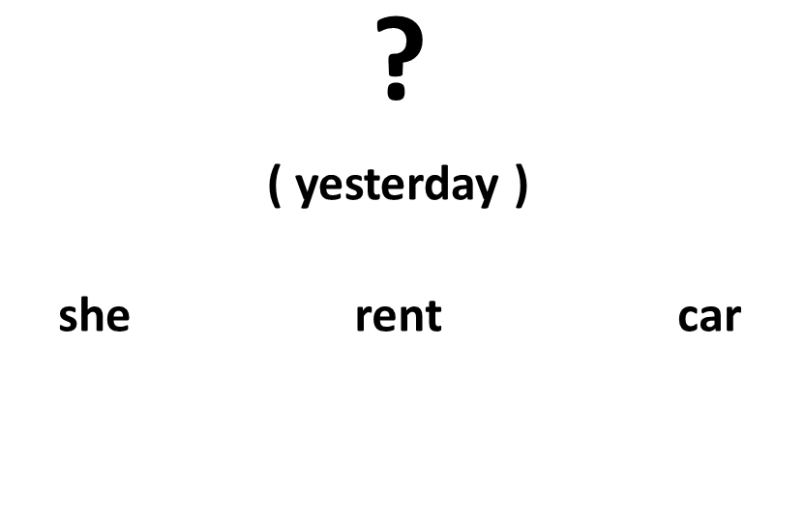
Measuring syntactic knowledge and speed: Sentence construction task
+
+
Based on:
Engelhardt et al.’s (2012) sentence construction task
Johnson & Newport’s (1989) findings regarding Chinese learners’ knowledge of English grammar

Slide 12
Analysis
Correlations between measures of cognitive fluency and utterance fluency
and
Correlations between measures of cognitive fluency and utterance fluency corrected for L1 using regression
Y = α + βx + error
L2 fluency = some constant + L1 Fluency + error
error = L2 fluency (correct for L1)
L2 fluency (corrected for L1) = some constant + lexical knowledge + error

Slide 13
Results: L1 and L2 oral fluency
 |  | L2 | L1 |  |  | r
Speech rate (syllables / speaking time) | M | 2.66 | 2.99 | ** |  | .54 | **
 | SD | .38 | .37
Articulation rate (syllables / phonation time) | M | 4.00 | 4.26 | ** |  | .52 | **
 | SD | .26 | .30
Pauses per minute (pauses / phonation time) | M | 48.30 | 38.71 | ** |  | .41 | *
 | SD | 11.86 | 9.01
Mean pause duration | M | .64 | .67 |  |  | .83 | **
 | SD | .14 | .17

Slide 14
Results: Lexical retrieval and syntactic production
 |  | M. | S.D.
Lexical | Knowledge (Total 32) | 19.06 | 3.54
 | Speed (seconds) | 2.37 | .29
Syntactic | Knowledge (Total 20) | 11.65 | 2.96
 | Speed (seconds) | 6.92 | 1.33
Notes:
Lexical speed is based on completion times for 15 known items, where known means 75% of participants responded correctly
Syntactic speed is based on completion times for 13 known items, where known means 50% of participants responded correctly

Slide 15
Results: Lexical and syntactic knowledge and speed and L2 fluency
 |  | Speech rate | Articulation rate | Pauses per minute | Pause duration
Lexical | Knowledge | .01 | -.11 | -.73 | -.01
 | Speed | -.22 | .07 | .24 | .22
Syntactic | Knowledge | .09 | .13 | .07 | -.09
 | Speed | -.18 | -.47 | -.04 | -.04
Notes:
Values in bold are significant at p < 0.01

Slide 16
Results: Lexical and syntactic knowledge and speed and L2 fluency (- L1 fluency)
 |  | Speech rate | Articulation rate | Pauses per minute | Pause duration
Lexical | Knowledge | .03 | .03 | -.06 | .25
 | Speed | -.22 | .01 | .26 | .07
Syntactic | Knowledge | .00 | -.03 | .01 | -.23
 | Speed | -.23 | -.60 | -.01 | -.23
Notes:
Values in bold are significant at p < 0.01

Slide 17
Discussion
L2 oral fluency appears to be constrained by individual characteristics, specifically individual cognitive processing and motor constraints
There are no differences between L1 and L2 fluency on some measures
There is a moderate to strong relationship between L1 and L2 fluency on all measures
Cognitive processes specific to the L2 were found to correlate with L2 oral fluency
The strength of these correlations increased when L1 fluency was partialled out
Processes specific to L2 appear to be important determinants of L2 fluency
Speed of syntactic processing appears to be an important component of oral fluency

Slide 18
Limitations
L1 cognitive processing, i.e. lexical speed and syntactic speed, were not controlled for
Our measure of syntactic speed potentially captures a wide range of processes involved in speech processing
Our measures confound knowledge and speed
Small effects may have not been detected due to the small (N = 34) sample size

Slide 19
Segalowitz’s (2010) model of the L2 speaker

Slide 20
Future directions
Fluency (broad) – Communicative adequacy
Lexical knowledge
Lexical speed
Fluency (narrow) – Speed and fluidity
Lexical knowledge
Lexical speed
Syntactic knowledge
Syntactic speed
Phonological knowledge
Syntactic knowledge
Syntactic speed
Phonological knowledge
Investigate a wider range of the fluency vulnerability points identified by Segalowitz (2010)
Compare models of proficiency and fluency

Slide 21
Thank you
British Academy Skills Acquisition Award
Department of Education, University of York, Pump Priming Fund
Ruby (Jiaying) Yu and Abby (Ping) Wang for support with data collection
Members of Centre for Research in Language Learning and Use, University of York and Members of the Cognitive Approaches to Second Language Acquisition Research Group, Universität van Amsterdam for insightful comments on the work in progress
Questions?
Contact: zoe.handley@york.ac.uk

Slide 22
References
Bosker et al. (2013). What makes speech sound fluent? The contributions of pauses, speed and repairs. Language Testing, 30, 159-175
Brodeur et al. (2010). The Bank of Standardized Stimuli (BOSS), a new set of 480 normative photos of objects to be used as visual stimuli in cognitive research. PLoS ONE, 5, e10773.
Brodeur, et al.(2014). Bank of Standardized Stimuli (BOSS) phase II: 930 new normative photos. PLoS ONE, 9, e106953.
De Jong et al. (2013). Linguistic skills and speaking fluency in a second language. Applied Psycholinguistics, 34, 893-916
Engelhardt et al. (2012). Are language production problems apparent in adults who no longer meet diagnostic criteria for attention-deficit/hyperactivity disorder? Cognitive Neuropsychology, 29(3), 275-299
Farrell & Abrams (2014). Picture-word interference reveals inhibitory effects of syllable frequency on lexical selection. The Quarterly Journal of Experimental Psychology, 67(3), 525-541

Slide 23
References
Johson & Newport (1989). Critical period effect s in second language learning: The influence of maturational state on the acquisition of English as a second language. Cognitive Psychology, 21, 60-99
Segalowitz (2010). Cognitive bases of second language fluency. London: Routledge.
Segalowitz & Freed (2004). Context, contact, and cognition in oral fluency acquisition. Studies in Second Language Acquisitioncy in advanced learners of French. Applied Linguistics, 17(1), 84-119
Title image: http://pixabay.com/en/photos/gears/

