Slide 1
Module 3 slides
Slides 75-94

Slide 2
Small & large cultures

Slide 3
Large and small cultures
Holliday (1999) distinguishes between’ large’ and ‘small’ cultures: ‘large’ refers to ethnic, national or international; ‘small’ signifies any cohesive group within society. Thus, small cultures can be any social grouping, including professional groups, neighbourhoods, families or groups of Erasmus students.
However, ‘large’ and ‘small’ does not just refer to size: the distinction implies also a different approach to culture. An emphasis on ‘large cultures’ tends to be essentialistic in that it focuses on the ‘essence’ of ethnic, national or international communities.
77

Slide 4
Small cultures
The concept of ‘small culture’ refers to a “dynamic ongoing group process that operates in changing circumstances to enable group members to make sense of and operate meaningfully within those circumstances” (Holliday, 1999, p. 248).
It focuses on the activities going on within the group, rather than on the nature of the group itself.
Members of small cultures, through their interactions, create discourse, which (re)creates, modifies, and transmits the culture and language of the small culture.
78

Slide 5
Large culture approach
Small culture approach
Reading cultures as originators of typical artefacts along with stereotypical behaviours, values, attitudes, beliefs
Allowing us to draw clear lines between ‘us’ and ‘them’
Essentialising descriptions of cultures as clearly differentiated, fixed units
Viewing individuals as determined by culture in terms of stereotypical behaviour, attitudes and values
Fixed cultural identity (defined by nation state)
Encounters leading to clashes/misunderstanding or else to assimilation
Questioning “what is people‘s cultural identity?”
Reading culture as an emergent, negotiated process, which is too complex and shifting to clearly define
Stressing the need to observe/interpret interaction between people in real life
Non-essentialist descriptions (based on ethnographic /anthropologic analysis of small groups)
Observing independence of an individual‘s social action, as human behaviour can never be determined
Pluralisation of identities /cultural hybridity
Encounters leading to experiential learning/co-construction of meaning, critical/reflective intercultural awareness
Questioning “how do individuals or groups construct and represent their cultural identity?”
Holliday, 1999
79

Slide 6
Some features of groups
Individuals, through their interactions with others, develop rules/guidelines for communication within and a group and beyond
An individual’s identity is informed, but not determined, by the group(s) to which s/he belongs
Groups are socially constructed through human interaction; they can form, develop, change and break up
Groups can be enduring/ongoing, or short-lived
80

Slide 7
Reverse culture shock

Slide 8
Reverse culture shock - what is it?
“Reverse culture shock is the process of readjusting, reacculturating, and reassimilating into one's own home culture after living in a different culture for a significant period of time” (Gaw, 2000, pp. 83-84). It may manifest for example in anxiety, stress, interpersonal difficulties, academic problems.
When sojourners return home after spending time abroad, they may have idealised ‘home’, or they may expect that things will be the same as when they left, without considering that friends and family have also moved on in their lives. This may cause a feeling of having to “readjust” again in the way that they had to adjust to their new lives abroad.
82

Slide 9
W-curve model (Gullahorn & Gullahorn, 1963)
83

Slide 10
However…
“Sojourners experience reentry in different ways; some individuals may experience few, if any, effects of reentry, while others appear to have problems [for a longer period] […]. While the theoretical literature states no returnee is exempt from reverse culture shock […], there are limited data to support this hypothesis. […] The empirical literature does not clearly indicate the severity of reverse culture shock as a problem nor to whom it is a problem” (Gaw, 2000, p. 84)
So… as with the concept of ‘culture shock’, handle with care.
84

Slide 11
Autoethnography

Slide 12
Autoethnography: components
“Autoethnography by definition operates as a bridge, connecting autobiography and ethnography in order to study the intersection of self and others, self and culture” (Ellingson & Ellis, 2008, p. 446)
“Auto/biographical research is research that starts from and focuses on the personal and subjective perceptions and experiences of individual people” (Sikes, 2006)
Ethnography as a research method implies studying a cultural group (though observations, interviews, etc.) to gain an understanding of how people make sense of their experiences
86

Slide 13
Autoethnography: the aims
“Autoethnography by definition operates as a bridge, connecting autobiography and ethnography in order to study the intersection of self and others, self and culture” (Ellingson & Ellis, 2008, p. 446).
The aim is to write personal experiences and analyze them in order to understand something that is beyond such personal experiences, i.e. something which is social. E.g.: how the kind of person we claim to be (after the Erasmus) influences and is influenced by others
87

Slide 14
Autoethnography: the process
Writing a narrative
Writing about past experiences selectively, using hindsight
Most often, autobiographers write about ‘epiphanies’ - remembered moments perceived to have significantly impacted on the trajectory of a person's life, […], and events after which life does not seem quite the same.
Supporting recall with ethnography
In writing, also by interviewing others and by consulting texts like photographs, journals, and recordings to help recall
Analyzing one’s own narrative
Considering ways others may experience similar epiphanies/narratives
Trying to use personal experience to illustrate facets of cultural experience
Ellis et al., 2011
88

Slide 15
Autoethnography: what is reality?
Autoethnography is embedded in a theory of knowledge (Constructionism) according to which:
The social reality that people experience as objectively true is in fact socially constructed (e.g., the concepts of ‘gender’, ‘youth’, ‘family’, ‘Erasmus community’). Concepts in turn influence the way people think, speak and act (e.g., as a man/woman or with respect to people ascribed to such categories)
Personal facts (memories, narratives, etc.) are potentially socially complex objects of study
Knowledge is not ‘out there’: people construct and shape it collaboratively.
Different voices must be heard to approach the ‘truth’ of personal and social facts
89

Slide 16
SOCIAL REPRESENTATIONS

Slide 17
Social representations
Social representations are a “system of values, ideas and practices with a twofold function; first, to establish an order which will enable individuals to orient themselves in their material and social world and to master it; and secondly to enable communication to take place among the members of a community by providing them with a code for social exchange and a code for naming and classifying unambiguously the various aspects of their world and their individual and group history” (Moscovici, 1973, p. xiii)
91

Slide 18
How social representations work
Social representations are co-constructed and shared with others. They allow a specific group of people to understand the world in a similar way, to consider a social fact ‘real’ and also ‘normal’.
Social representations are normative. They say what behaviour is preferred or disapproved of in a given context or in a given society at large. They thus make social order possible and bind a society together.
Social representations are dynamic. They change over time. Changes are often due to contestation: “Group members constantly refer to multiple and competing types of normative reference knowledge […]. By taking up a position, they then either support or reject shared knowledge” (Staerklé et al., 2011, p. 763)
92

Slide 19
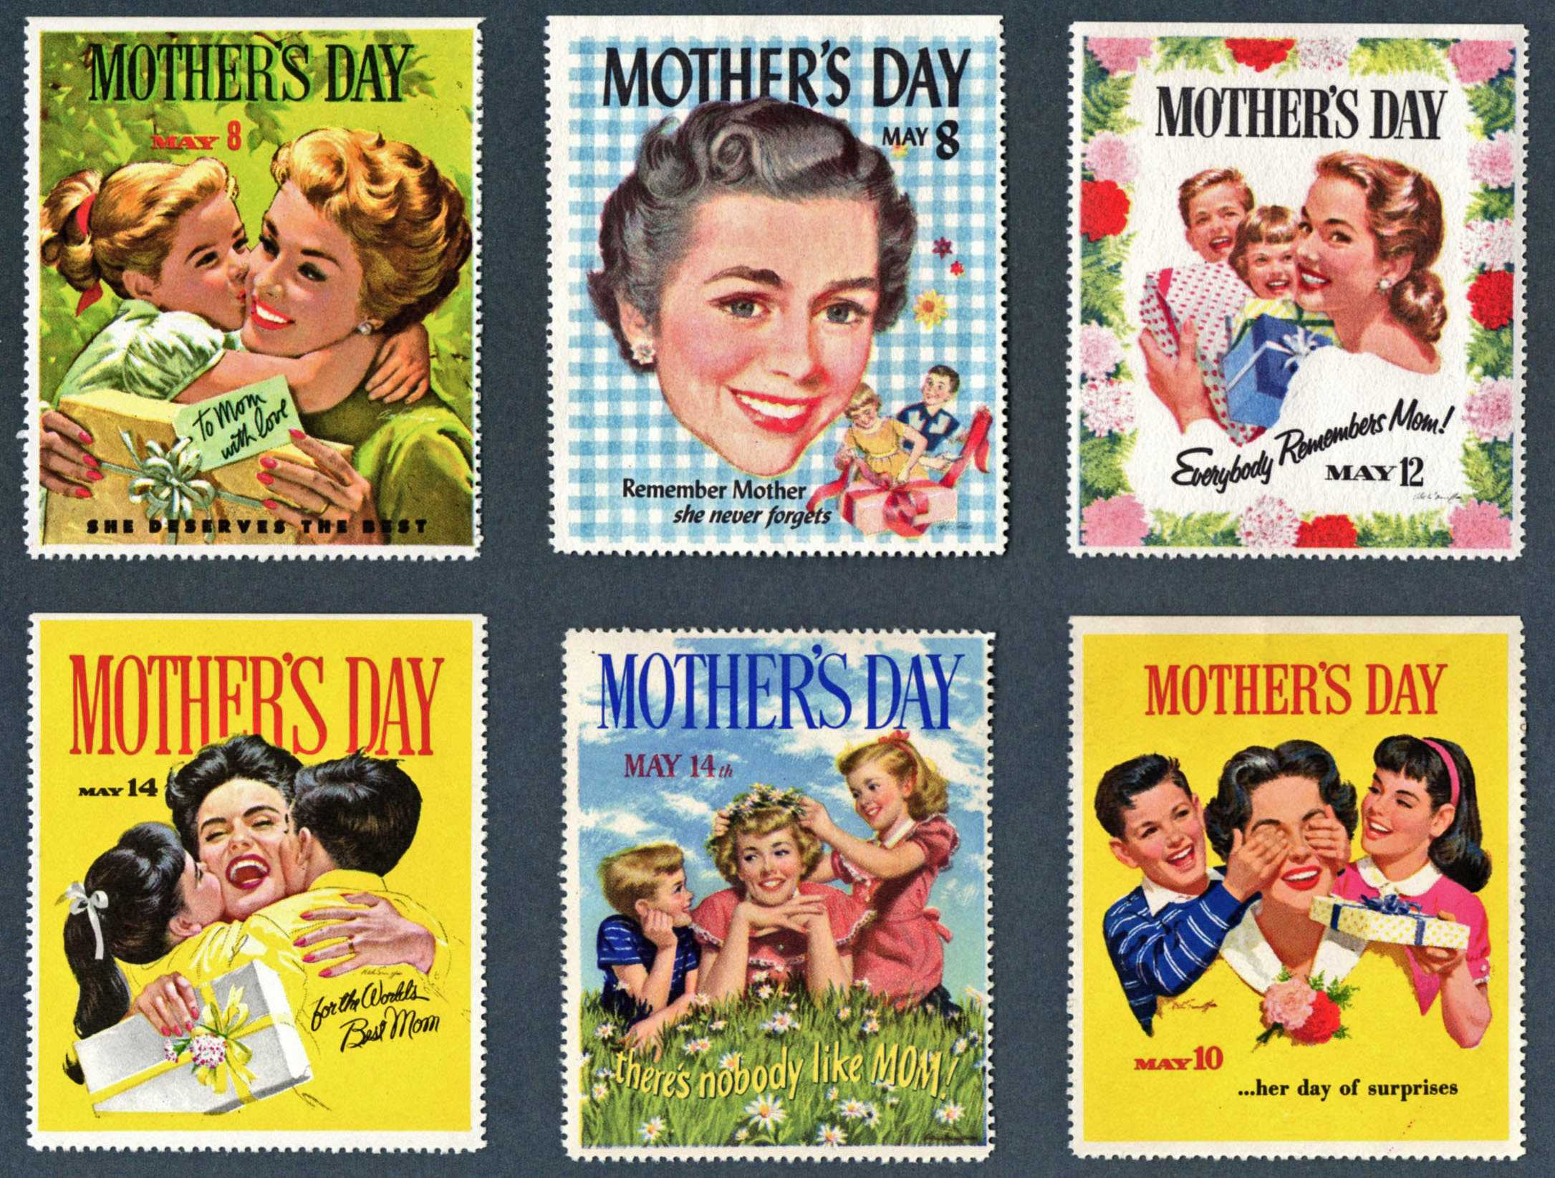
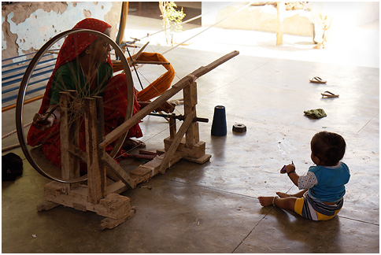
Social representations: an example
What is expected from a mother (always being happy, working hard to sustain the family, stimulating her children with games, etc.) depends on the social representation of ‘motherhood’ in a given society at a given time.
See the images’
CC licences
here
93

Slide 20
Creative commons

