Slide 1
Working Abroad
Languages and Social Networks Abroad Project.
Pedagogical Guide 3
Designed by: L. P. Romero de Mills
Notes:
The time proposed for this workshop is 1:30hrs. Times are approximate, depending on the flow of the course and participants’ engagement in the group discussion.
The main aim is to provide students with an opportunity to reflect on the opportunities and possible difficulties that could arise from being teaching assistants in a different country. It could be applied to the Teaching Assistantships organised by the British Council or similar schemes.

Slide 2
Why working abroad?
Notes:
Stage 1: Common beliefs.
Activity 1a: Make a list of the benefits this scheme could offer to participants.
Aim: To review some of the benefits that organizations such as ’Global Experiences’ advertise as advantages for taking part in these programmes, and to compare them with participants’ personal view on (understanding of) the opportunities open to them.
Time: 5 minutes
Classroom arrangement: Pair work, then Forum (Teacher-student)
Procedure:
Allow students to work in pairs in order to make a list of 3-5 reasons why they think a work placement would be a good option for someone thinking about spending a year abroad. (3-5 minutes)
Collect their thoughts and work out a list of the different reasons mentioned.
Play the video “Global Experiences: Why Intern Abroad?” (Next slide).
Notes: If students haven’t chosen this scheme yet, you can focus on why they would choose it.

Slide 3
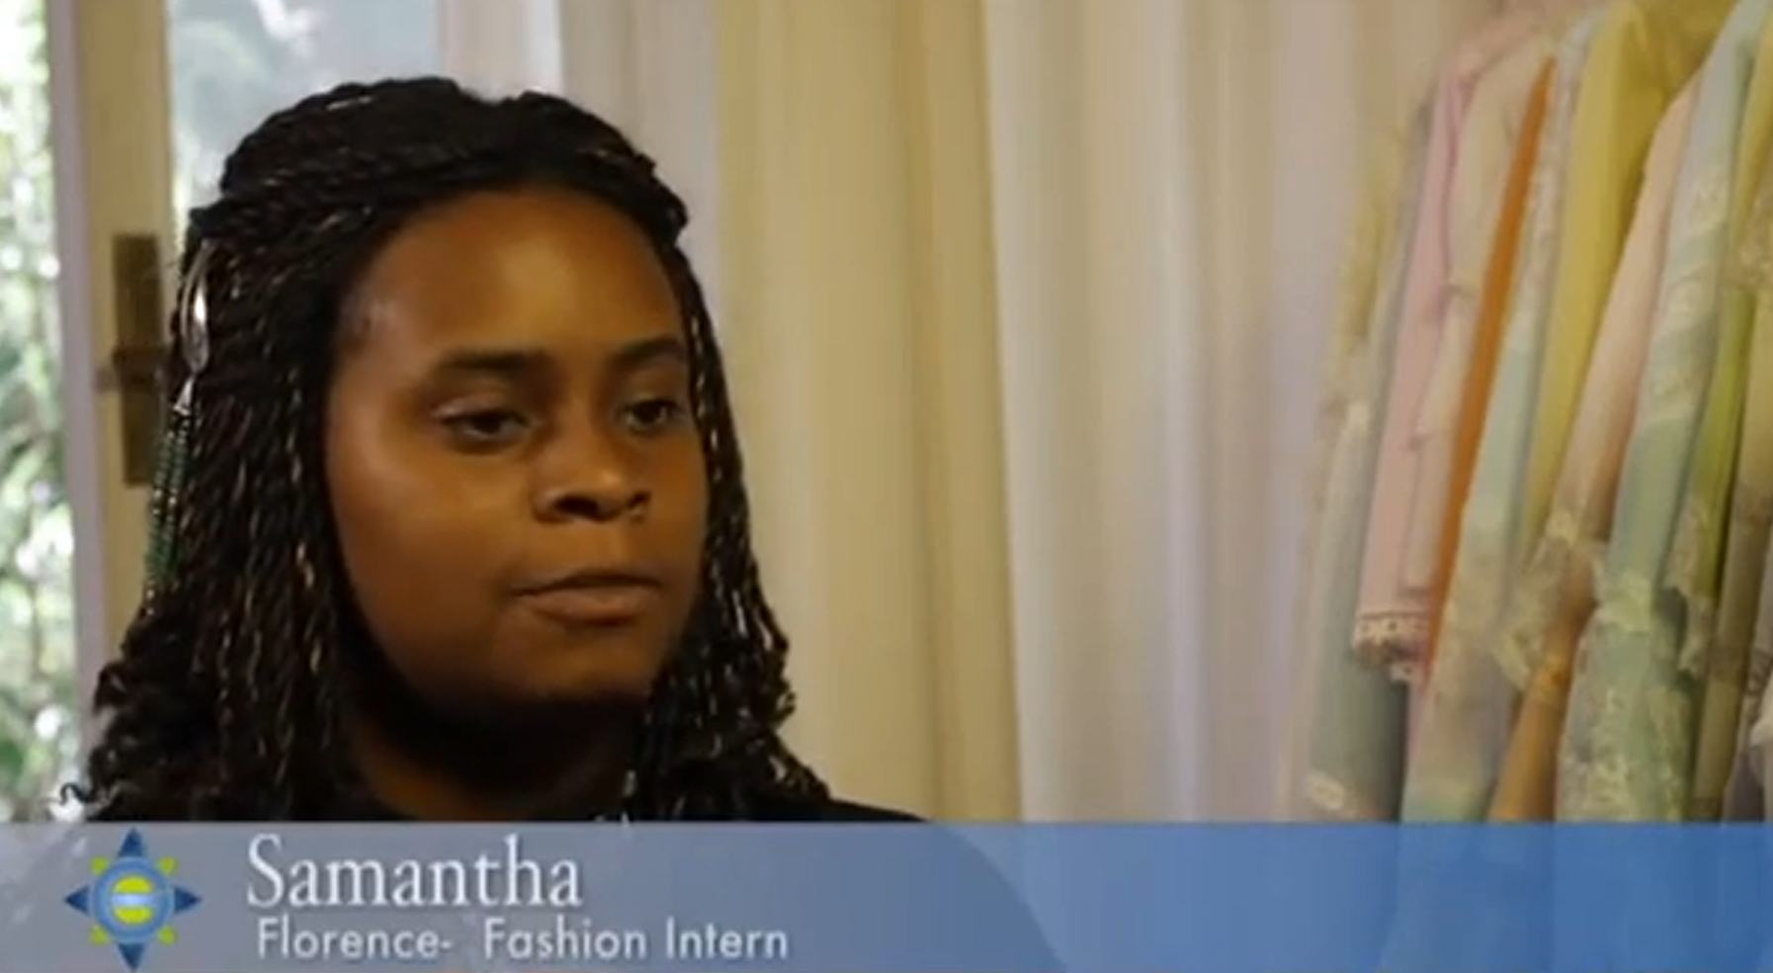
Why working abroad?
Notes:
Stage 1: Common beliefs.
Activity 1b: Make a list of the benefits this scheme could offer to participants.
Aim: To contrast participants’ expectations of the scheme with the advert to be analysed.
Time: 7-10 minutes (the video lasts 2’ 47’’, and there’s no need to play it twice).
Classroom arrangement: Individual, then pair work.
Procedure:
Ask students to write down the benefits of participating in this internship programme the speakers on the video mention/identify. Make a note about the way they describe their experience.
After they have watched it, ask them to get in pairs and compare their notes. Are these some of the objectives they are hoping to achieve too? Is this what they imagine a work placement would be?
Notes: https://www.youtube.com/watch?v=QodAhQbrpbI (hover on the image, and click on it to go directly to the video)

Slide 4
Why working abroad?
"It's something that will change your life”
"I couldn't get this experience anywhere else, it's hand-on”
"if you don't have an incline of what you want to do this definitely an opportunity you can pass on"
"I love the work I do, I love the city, I'm incredibly happy to be here"
"it's all about making you as comfortable as you can be"
"makes you open up to learning new things and juts embracing the culture. This has pushed me to my limits, being away from home for this long, but I know that when I get back I will be so much better for it”
Notes:
Stage 1: Common beliefs.
Activity 1c: Review some the content of the promotional video we have just watched.
Aim: To reflect on the promotional information watched and to contrast this to participants’ own expectations/understanding of the scheme. To remind students most promotional video, perhaps including those produced by their own university, tend to highlight the bright side of the scheme they are trying to promote. But, can they think of any examples we don’t learn from this video?
Time: 3-5 minutes
Classroom arrangement: Forum.
Procedure:
Project the this extracts from the video, and ask students if they can think of any aspects of this experience the video is not showing.
The following slides will focus on a number of examples.
Notes: We have focused on aspects that can be backed up by data, but it is not exhaustive.

Slide 5
Case 1:
You will develop your problem-solving skills.
Notes:
Stage 2: Questioning common beliefs
Activity 1: Studying a real-life case.
Aim: To present students with scenarios they could be phasing when going abroad, and help them reflect on the opportunities open to them in this respect.
Time: 10-12 minutes
Classroom arrangement: Forum, then pair work.
Procedure:
(Next slide)

Slide 6

Interview with student before departure:
Read the following quote:
"I will work in a company in Madrid. I will be working in two languages, French and Spanish, and I will be doing practice work in journalism and communications; I will be working in a section called 'Business', where they produce guides for investors in the US and Europe who want to expand their business to countries in development such as El Salvador or Chile"
(0150aPRM)
Notes:
Notes:
The job sounds ideal: working with two languages, in the chosen location, networking with people from around the world, etc.
What could have gone wrong?

Slide 7
Interview with student a few months into her year (November)
"I was working in [company], five minutes from my flat, and was doing work on journalism and marketing, and I had to improve our strategy for marketing and to make guides […] but the company had financial problems […] they hadn't paid any of their employees in two months.
But no one was saying anything because they were all scared they would be fired if they said they needed their money […]
It was hard because I had moved to Spain for this job, and it was interesting, but I couldn't continue living with no money"
(0150bNTV)
Notes:
Notes:
The job sounds ideal: working with two languages, in the chosen location, networking with people from around the world, etc.
What could have gone wrong?

Slide 8
Interview with student a few months into her year (November)
“[there were other] practical problems such the NIE, the ID number for foreigners, which is not easy to do. It’s better to do it outside Madrid or Barcelona, because if you try to do it in the city, it takes a long time. I asked for it, and they gave me an appointment for a date nine months later! And it’s ridiculous.” (NTV, 150c)
Notes:
Notes:
The job sounds ideal: working with two languages, in the chosen location, networking with people from around the world, etc.
What could have gone wrong?

Slide 9
Interview with student a few months into her year (November)
“and I didn’t have a bank account, so I was surviving using just cash, my salary in cash, but that’s not the right way to do it…” (NTV150c)
Notes:
Notes:
The job sounds ideal: working with two languages, in the chosen location, networking with people from around the world, etc.
What could have gone wrong?

Slide 10

Case 1:
You will develop your problem-solving skills.
What would YOU have done in her case?
Discuss with your partner and think of at least two different alternatives.
Notes:
Stage 2: Questioning common beliefs
Activity 1b: Studying a real-life case.
Aim: To get students to think of what alternatives they have, if faced with a similar situation.
Time: 5-7 minutes
Classroom arrangement: Pair work, and then forum.
Procedure:
Allow students to discuss in pairs and think of different alternatives; perhaps, be the one confronting the bosses? Changing jobs? Moving to a different city?
In a forum arrangement pick a few of their thoughts and discuss pros and cons.
Notes: This is not to give a students a definite solution, but to help them/remind them they can think of more than one possible alternative and the process of assessing pros and cons.

Slide 11
Case 2:
You will develop resilience and your negotiating skills.
Notes:
Stage 2: Questioning common beliefs
Activity 1b: Studying a real-life case.
Aim: To get students to think of what alternatives they have, if faced with a similar situation.
Time: 5-7 minutes
Classroom arrangement: Pair work, and then forum.
Procedure:
Allow student to discuss in pairs and think of different alternatives; perhaps, be the one confronting the bosses? Changing jobs? Moving to a different city?
In a forum arrangement pick a few of their thoughts and discuss pros and cons.
Notes: This is not to give a students a definite solution, but to help them/remind them they can think of more than one possible alternative and the process of assessing pros and cons.

Slide 12
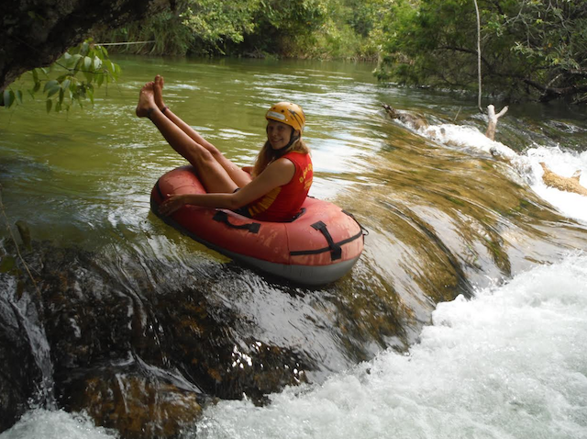
Read the following sections of an article:
"Katie is a BA Spanish and Portuguese student at the University of Southampton, going into her final year. She spent 9 months of her year abroad on an AIESEC Brazil Internship as a Tubing Monitor in ecotourism hotspot Bonito, exploring the area and working on her blog in her free time. She rounded things off with three months travelling through Brazil, Bolivia, Peru, Chile, Argentina and Uruguay. In this piece, she tells us about her fantastic experience working abroad!”
Source: Uniacke, K. 10 reasons my work placement “thirdyearabroad.com”
Notes:
Notes:
The job sounds ideal: working with two languages, in the chosen location, networking with people from around the world, etc.
What could have gone wrong?

Slide 13
Read the following sections of her article:
“Working in such a different culture is never going to be easy, and my internship did in fact end in tears over differences in opinion regarding my contract of 44 hours a week vs. the reality of 66 hours […]”
“One of the downsides of working in tourism is that in high season you might not see a day off for weeks at a time […]”
Source: Uniacke, K. “10 reasons my work placement was a dream”. thirdyearabroad.com (2015)
Notes:
Notes:
The job sounds ideal: working with two languages, in the chosen location, networking with people from around the world, etc.
What could have gone wrong?

Slide 14
Case 2:
You will develop resilience and your negotiating
What do you think Katie has learned from this experience? Can you imagine yourself in this situation? How would you have reacted?
Notes:
Stage 2: Questioning common beliefs
Activity 1b: Studying a real-life case.
Aim: To get students to think of what “opportunities” to grow personally and intellectually open to them when they are faced with difficult situations.
Time: 5-7 minutes
Classroom arrangement: Pair work, and then forum.
Procedure:
Allow student to discuss in pairs Katie’s case and the proposed reflective questions projected on the screen. Conmtrast their predictions/thoughts with Katie’s final remarks.
In a forum arrangement pick a few of their thoughts and discuss pros and cons.
Notes: This is not to give a students a definite solution, but to help them/remind them they can think of more than one possible alternative and the process of assessing pros and cons.

Slide 15
Read the following sections of her article:
“I learnt how to stand up for myself and I’m pretty confident I could deal with any work issue that life cares to throw at me. Plus you know you’ve got good at a language when you can have a fluent ‘heated discussion’ in it.”
“One of the downsides of working in tourism is that in high season you might not see a day off for weeks at a time, but one of the perks was that, when you did get a rest, you could get free entry to some of the other activities in the area on your days off. I went snorkelling, diving, abseiling and trekking and swum in some of the most beautiful waterfalls I’ve ever seen.”
Source: Uniacke, K. 10 reasons my work placement “thirdyearabroad.com”
Notes:
Notes:
These are Katie’s remarks on the lessons she learned from the experience. Research shows ‘confidence’, for example, is invariably one gain students report having obtained from the experience of living (and working) abroad.

Slide 16
Case 3:
You will experience some of the complexities the relationship between language and identity gives rise to, first-hand!
Notes:
Stage 2: Questioning common beliefs
Activity 1b: Studying a real-life case.
Aim: To get students to think of what alternatives they have, if faced with a similar situation.
Time: 5-7 minutes
Classroom arrangement: Pair work, and then forum.
Procedure:
Allow student to discuss in pairs and think of different alternatives; perhaps, be the one confronting the bosses? Changing jobs? Moving to a different city?
In a forum arrangement pick a few of their thoughts and discuss pros and cons.
Notes: This is not to give a students a definite solution, but to help them/remind them they can think of more than one possible alternative and the process of assessing pros and cons.

Slide 17
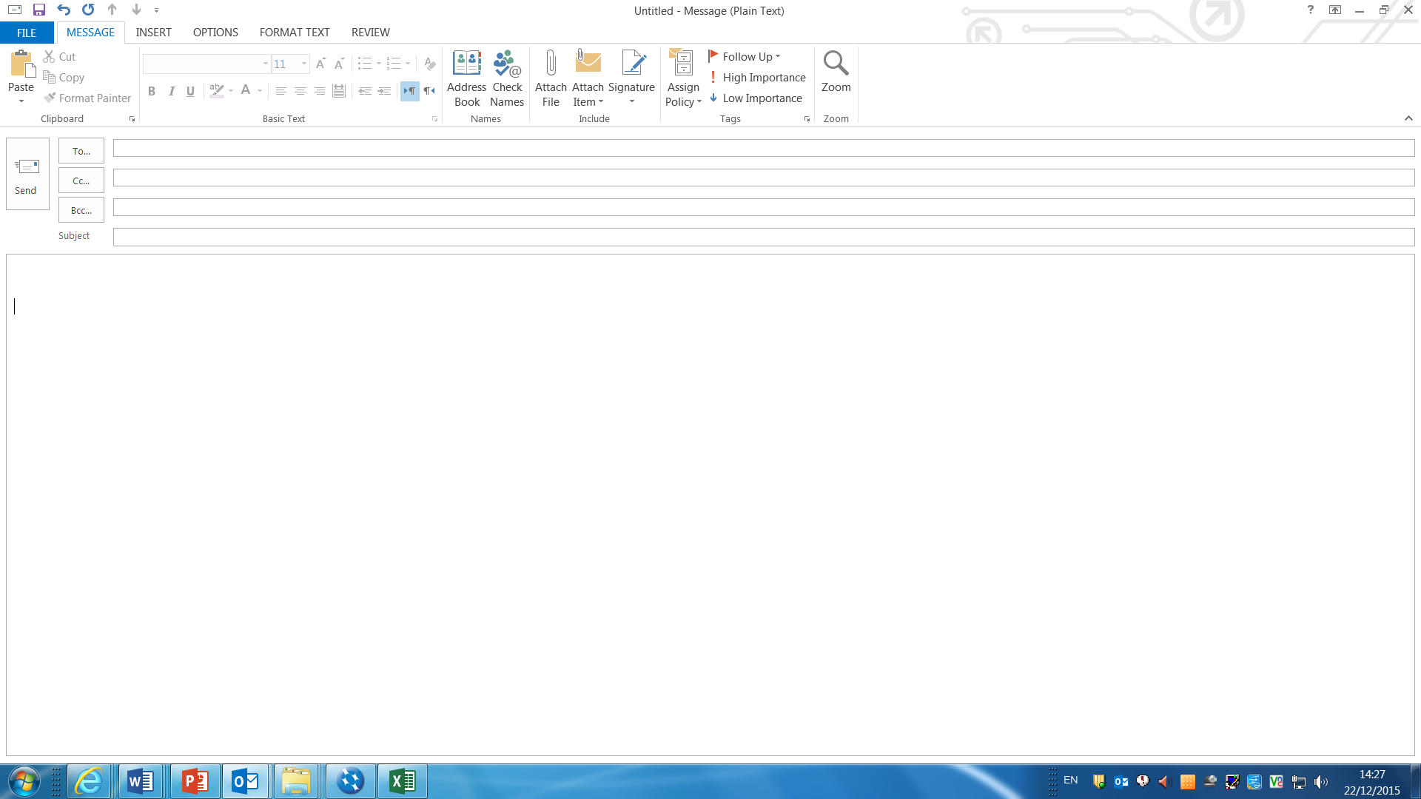
What would you do?
Since living in [country] , my confidence in my ability to speak [the target language] has improved significantly, I have had four native speakers compliment me on my fluency and my authentic accent - which of course is the best of compliments for a languages student!!
However, this is not reflected in my place of work...
I really struggle to buck up the courage to speak [the target language] confidently in my office. My mentor tends to speak English to me, in general, to explain important tasks that I must complete, but the rest of the office (and colleagues in other offices) speak to me in [the target language] . However, I really struggle to string a sentence with them (even though, I KNOW that I can speak well).
Do you have any advice on what I can do? I have thought about trying to speak to my exchange coordinator in [country] , to diplomatically explain my worries, but as I said, everytime I try to string a sentence together, it fails miserably with stutters and silly mistakes. But I really do try, and want to be able to join in with the office conversations more to help me improve.
Notes:
Stage 4b: Planning together
Activity 6a: Discussing strategies to cope with possible scenarios: Teaching subjects through English.
Aim: To allow student to think of possible strategies BEFRORE the workshop convenor provides any.
Classroom arrangement: Pair work/small groups.
Time: 5-7 minutes.
Procedure:
Project this quote (or provide the relevant hand-out).
Ask students to think about 2-3 possible solutions/suggestions they could give to the author of this e-mail.
What could they do from today to prepare for this possible scenario?

Slide 18
What can we conclude from Case 3?
Notes:
Stage 4: Raising awareness (questioning common beliefs).
Activity 5a: Exploring the role of a TA
Aim: To contrast the ‘official’ description of the TAs’ activities available on the BC website with academic research on the topic, including Langsnap data.
Time: 8-10 minutes
Classroom arrangement: Forum
Procedure:
- Follow the presentation on the screen (slides 12-17).

Slide 19
Language and the self:
“To learn another language is to redefine yourself publicly, socially, and personally. No other topic of education so deeply affects the individual’s own self-presentation in society”
Pellegrino Aveni, V. (2005)

Slide 20
Language and the self:
“Language is not only a primary means of human communication, but also a symbol of cultural and social unity and division, a fundamental mechanism of self-presentation and social identity, and is simultaneously an instrument of power and source of weakness for its users”
Pellegrino Aveni, V. (2005)

Slide 21
Language and the self:
“Language is not only a primary means of human communication, but also a symbol of cultural and social unity and division, a fundamental mechanism of self-presentation and social identity, and is simultaneously an instrument of power and source of weakness for its users”
Pellegrino Aveni, V. (2005)

Slide 22
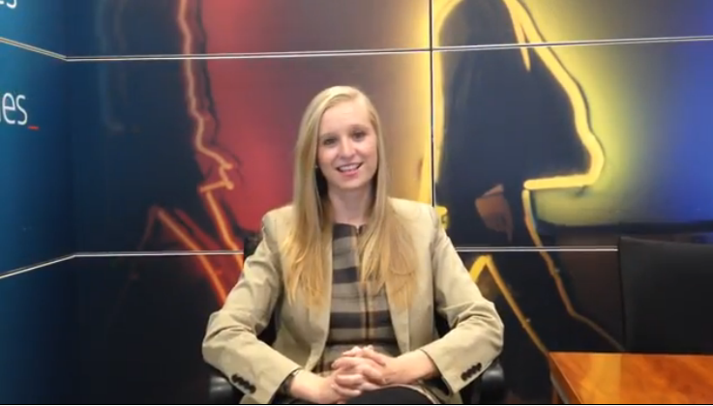
But, is it worth it?
Notes:
- (0:41) talks about her YA, and she is the same student that had to suddenly leave her job, and start again!

Slide 23
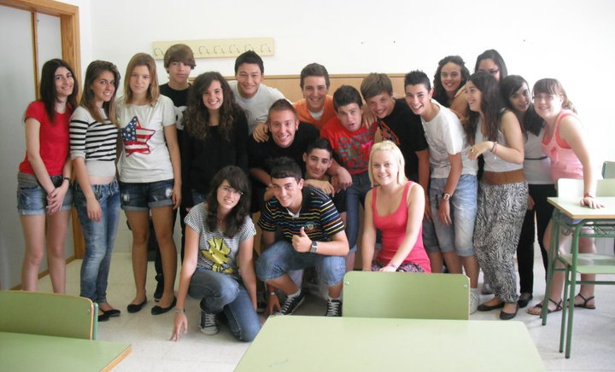
Top tips?

Slide 24
Think about these*:
Be flexible
Plan well but be willing to give unexpected turns.
Your colleagues, may not be your friends, so make friends outside the office.
Keep appropriate boundaries with colleagues and bosses
Be aware of the way the office works, but READ your contract carefully.
Notes:
Notes: Please see bibliography to access the full article.

Slide 25
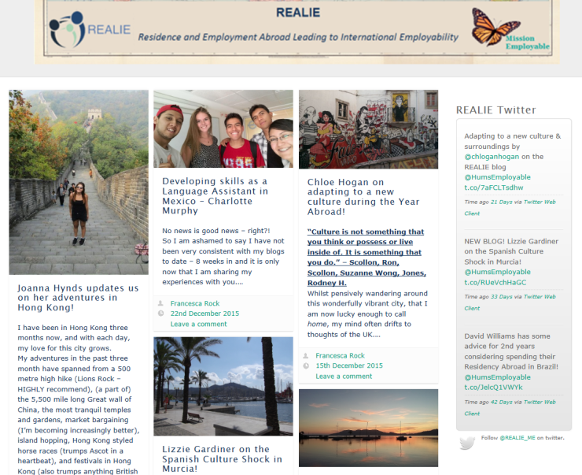
FAQ:
How to get a placement.
Types of work available and your CV
Follow our UoS student bloggers!
Notes:
Notes: Please see bibliography to access the full article.

Slide 26
GOOD LUCK! ☺
Notes:
Please refer to the lesson plan and tutor’s notes accompanying this presentation to find a few follow-up activities students could develop on their own time as homework. They could also be used as preparation for a follow-up seminar to this workshop.
We hope you found this guide useful.
Dr Patricia Romero de Mills and the Langsnap team.

Slide 27
Credits and Bibliography
THE LANGSNAP TEAM (University of Southampton):
Prof. Rosamond Mitchell
Dr L. Patricia Romero de Mills
Laurence Richard
Dr Nicole Tracy-Ventura
Dr Kevin McManus
Claire St. John (Research assistant)
Quotes from interviews to students extracted from:
Mitchell, et al Languages and Social Networks Abroad Project (LANGSNAP). 2013. Accessed 09
September, 2015. Available from: https://langsnap.soton.ac.uk/
IMPORTANT: This guide was designed by Dr L. Patricia Romero de Mills, Lansnap co-investigator. It was designed with the intention to be shared with all educators, administrators or other professionals who require to prepare undergraduates for study abroad. The materials can be modified and adapted to particular needs free of charge, but the intellectual property of this initiative must be acknowledged by citing the original guide, and the source where it can be found. All the credits to the Langsnap team and project must be clearly displayed on any modified versions you create. No modified versions of this work should be shared; professionals interested in modifying this original version must download it from:
For any questions please contact Dr L. Patricia Romero de Mills at: P.romero@soton.ac.uk

Slide 28
Credits and Bibliography
Bibliography:
British Council. 2013. British Council Language Assistants: Sally Gascoigne. Accessed 21/12/2015. Available from: https://www.youtube.com/watch?v=UP7s6-7OmS8
British Council. 2105. ‘What will I do?’ Become a Language Assistant. Accessed: 22/12/2015. Available from: https://www.britishcouncil.org/language-assistants/become/what-will-i-do
Chenia, S. 2014. Ten Reasons to Become and English Assistant Vices Magazine, British Council. 16th December, 2014. Accessed 21/12/2015. Available from: https://www.britishcouncil.org/voices-magazine/ten-reasons-become-english-language-assistant
Merick K. (2012) Top Ten Tips for Surviving as a Language Assistant. TheThirdYearAbroad.com. Available from: http://www.thirdyearabroad.com/work-abroad/teach-abroad/item/1153-10-tips-survival-as-a-language-assistant.html. Accessed 22/12/2015.
Mitchell, et al. 2013. The influence of social networks, personality and placement type on language learning during residence abroad: Preliminary findings of the LANGSNAP project. Residence Abroad, Social Networks and Second Language Learning Conference, April 2013, University of Southampton. Available from: http://langsnap.soton.ac.uk/conferencePresnetations.html
Giraud-Johnstone. 2012. “Assessing the Work Placement Abroad”. Scottish Languages Review. SCILT 25, 19-28.
“What I’ve learned from studying abroad” (Bolg). The Guardian. http://www.theguardian.com/education/mortarboard/2014/may/06/students-study-abroad-tips
Image on Slide 16, “Gnome-face-uncertain” by GNOME Icon artist. CC-BY-SA-3.0 Via https://commons.wikimedia.org/wiki/File%3AGnome-face-uncertain.svg
Image on Slide 20, “Biology class 06” by NVO. CC-BY-SA-3.0 Via https://commons.wikimedia.org/wiki/File%3AMIBF_2011_biology_class_06.JPG

