Slide 1
Holocaust: brief history
PowerPoint adapted from:-
http://www.elpasoholocaustmuseum.org/presentation.sstg
http://worldhistory.pppst.com/holocaust.html

Slide 2
“You have no right to live among us as Jews.”

Slide 3
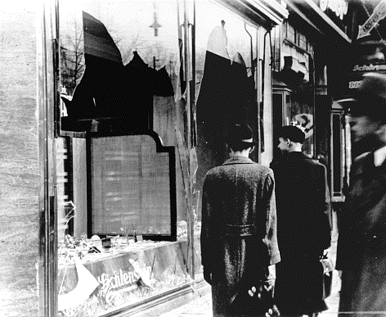
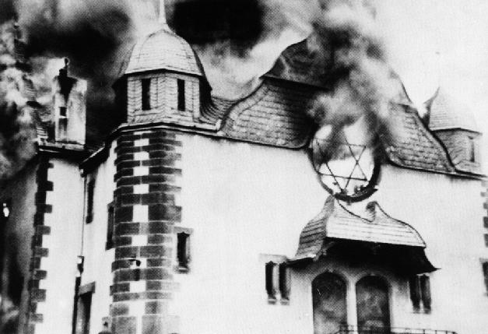
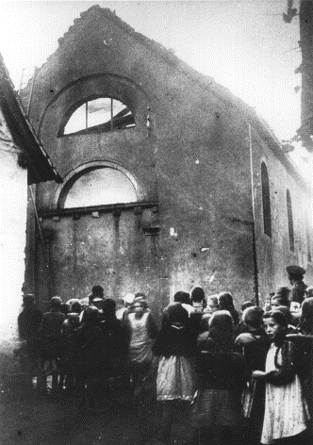
Kristallnacht
“Night Of Broken Glass”
Photo credits: Hauptstaatsarchiv Stuttgart, courtesy of USHMM Photo Archives
November 9-10, 1938
Notes:
“Night of Crystal” or “Night of Broken Glass” – a government organized riot.
A form of terrorism.
Kristallnacht was the name given to the first major attack on the Jewish population of Germany and Austria on November 9-10, 1938. The proclaimed objective of the Nazi regime was to rid Europe of its Jewish population. In November 1938, following the assassination of a German diplomat in Paris by a young Jewish student trying desperately to help his parents obtain visas to return to their homeland, all synagogues in Germany were set on fire, windows of Jewish shops were smashed, and thousands of Jews were arrested. The “Night of Broken Glass” (Kristallnacht) was a signal to Jews in Germany and Austria to leave as soon as possible. Several hundred thousand people were able to find refuge in other countries, but a similar number, including many who were old or poor, stayed to face an uncertain fate.
November 8, 1938, at an annual celebration at a beer hall, Hitler was overheard telling Goebbels, Hitler’s Chief of Propaganda, that the “SA should have a fling”
The event was described as a “spontaneous” outrage of German anger against the Jewish population because of the murder of the German diplomat. It also served as “proof” that the Jews were depicted honestly in the Nazi propaganda campaign. Nazi offices all over Germany were given specific details as to what to do during this progrom: burn synagogues, smash windows of Jewish businesses, ransack Jewish businesses and homes, and arrest all Jewish males, taking them to concentration camps. Over one hundred Jews were killed that night; others were subjected to torture. An estimated 20,000 children were left homeless and fatherless by the destruction of Kristallnacht and imprisonment of Jewish men.

Slide 4
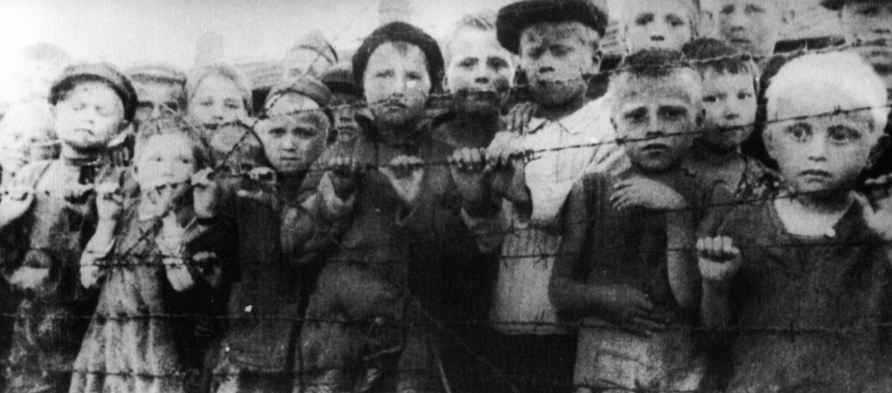
“You have no right to live among us.”
Notes:
Living in ghettos.

Slide 5
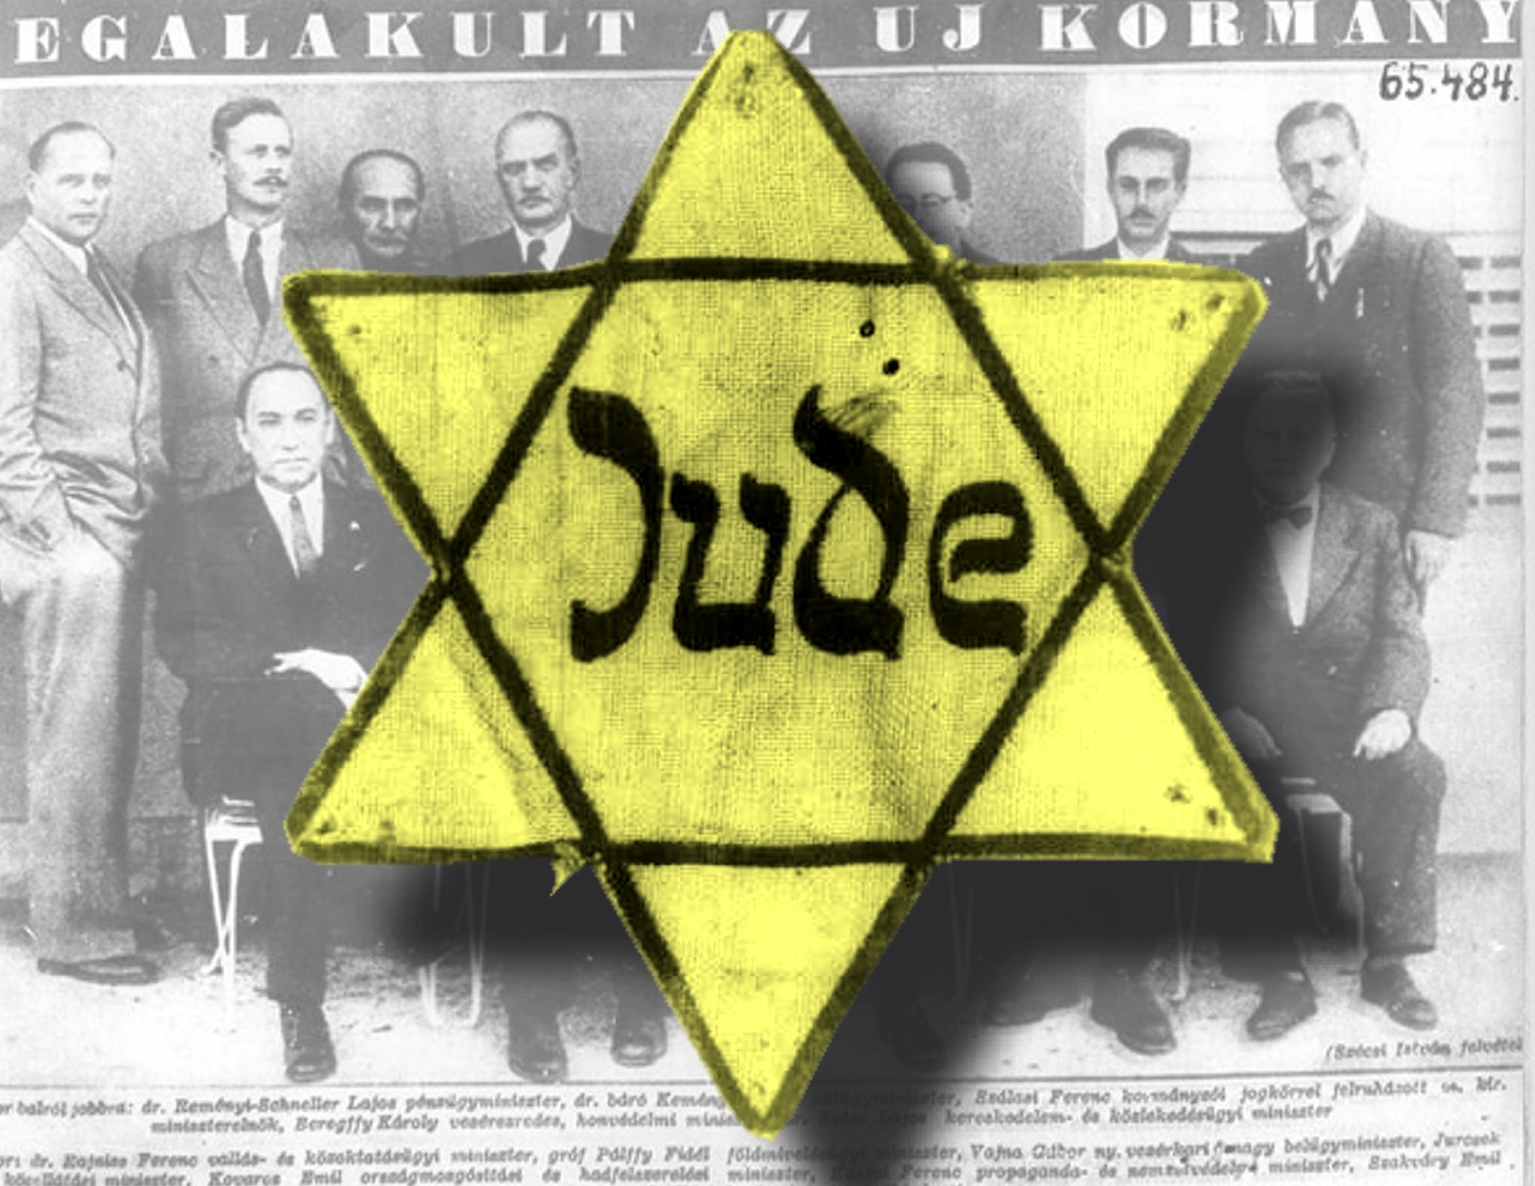
Notes:
Badges helped Nazis keep track of Jews and others not only in prison camps but also in communities across Nazi-controlled territory. The badges people wore were mandated and had nothing to do with any personal choices they had made.

Slide 6
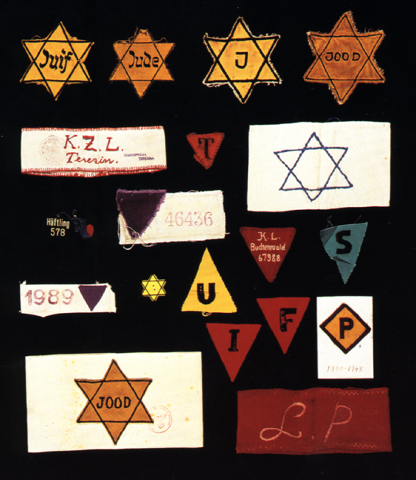
Notes:
ACTUAL BADGES

Slide 7
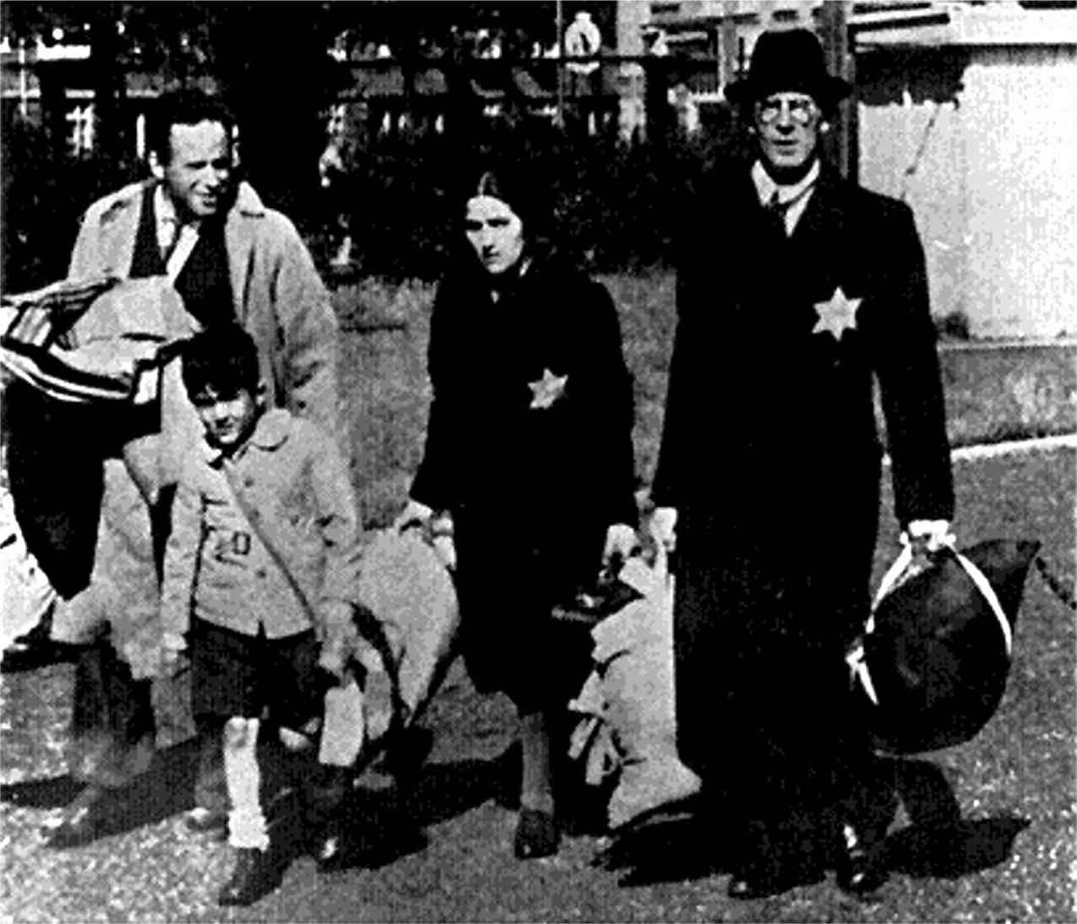
Family being forced into Ghettos
Notes:
SLIDE 21 – FAMILY BEING FORCED INTO GHETTOS
The Nazi policy quickly changed and instead of forcing Jews to emigrate, the policy became one of annihilation. Def. To reduce to nothing, to destroy.
The Nazis began to roundup Jews throughout Europe. The victims were first put in ghettos and told that when labor camps were built, they would be resettled in special work areas.
Ghettos were located in Eastern Europe, and they were located in the poorest section of the city. Ghettos were enclosed either with a brick wall or barbed wire fence.
Entire neighborhoods set up to be similar to prisons/jails with armed guards at all gates.

Slide 8
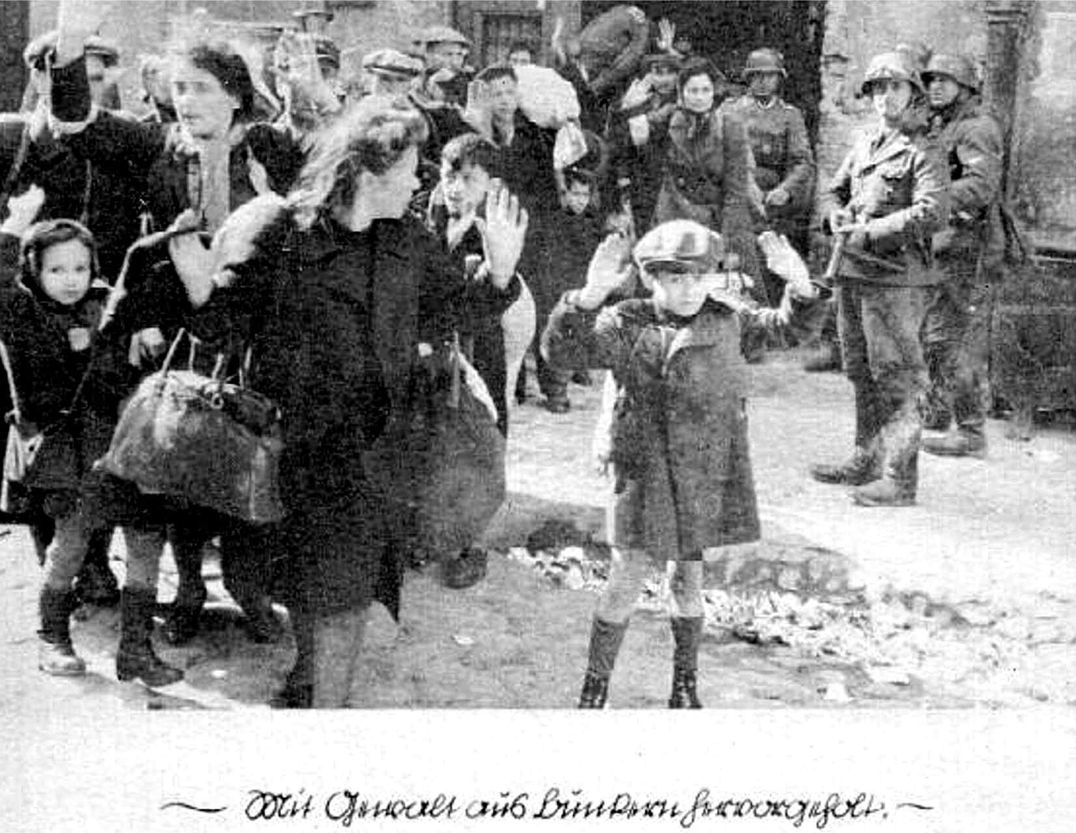
People being “resettled” to Concentration Camps
Notes:
Whenever the Nazi officials in charge decided, a certain number of ghetto residents were ordered to report to rail stations for resettlement/relocation somewhere else.
Thinking that life could only be better away from the disease-ridden ghettos, victims willingly accepted resettlement.
In order to avoid panic in the ghettos, the Nazis allowed families to travel together to the death camps. This is one of many examples of mind games played by the Nazis for cooperation .

Slide 9
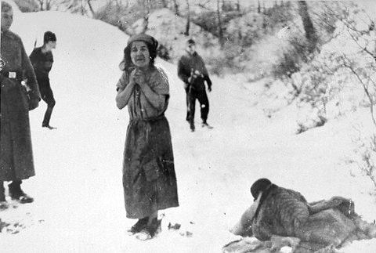
“You have no right to live !”
Photo credit: Leopold Page Photographic Collection
Notes:
Sent to concentration camps and/or death camps.

Slide 10
Prelude to the Final Solution
When Hitler seized power in 1933 he used his new powers under the ‘Enabling Law’ to begin his attack on the Jews.
In 1938, the Nazi attack on the Jews changed and became more violent with Himmler launching Kristallnacht on 11th November 1938.
By 1939, half of Germany’s 500,000 Jews had emigrated to escape Nazi persecution.

Slide 11
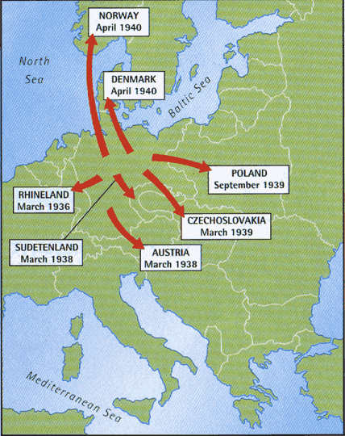
Prelude to the Final Solution
In 1939, Germany invaded Poland which had a much larger population of 3 million Jews.
In 1941, Germany invaded Russia which had a population of 5 million Jews.

Slide 12
The ‘Final Solution’
In January 1942, Himmler decided to change tactics once again and called a special conference at Wannsee.
At this conference it was decided that the existing methods were too inefficient and that a new ‘Final Solution’ was necessary.

Slide 13
Reinhard Heydrich
Nicknamed “The Blond Beast” and “Hangman Heydrich”
second in command of Gestapo and SS
principle planner of the Final Solution
Brigadier General in SS at the age of 30

Slide 14
Wannsee Conference
Women, children, the old & the sick were to be sent for ‘special treatment.’
The young and fit would go through a process called ‘destruction through work.’
Shooting was too inefficient as the bullets were needed for the war effort
On arrival the Jews would go through a process called ‘selection.’
How was the Final Solution going to be organised?
Jews were to be rounded up and put into transit camps called Ghettoes
The remaining Jews were to be shipped to ‘resettlement areas’ in the East.
The Jews living in these Ghettos were to be used as a cheap source of labour.
Conditions in the Ghettos were designed to be so bad that many die whilst the rest would be willing to leave these areas in the hope of better conditions

Slide 15
How did the Nazi decide who was Jewish?
At the Wannsee conference it was decided that if one of person’s parents was Jewish, then they were Jewish.
However, if only one of their grandparents had been Jewish then they could be classified as being German.
In 1940, all Jews had to have their passports stamped with the letter ‘J’ and had to wear the yellow Star of David on their jacket or coat.
Notes:
Some historians believe that Hitler’s grandfather was Jewish. His Grandmother used to work for a rich Jewish landowner in Austria and it is believed that she had an affair whilst she worked as his house keeper. He later helped his son get a job as a civil servant. Some Psychologist put this down as being one of the possible reasons why Hitler hated Jews. However, it is interesting to note that the Jewish doctor who helped his mother whilst she was dying of cancer was dropped off at the Swiss boarder by the SS in 1940!

Slide 16
FINAL SOLUTION
“Now judgement has begun and it will reach its conclusion only when the knowledge of the Jews has been erased from the earth!” Nazi Newspaper
there were 3 phases of the Nazi plan to wipe out the Jewish population of Europe

Slide 17
Phase 1 = Shooting
Jews were rounded up and told they were to be relocated
They were taken to the woods and were shot one by one
their bodies were buried in mass graves

Slide 18
Einsatzgruppen
Himmler sent four specially trained SS units called “Einsatzgruppen battalions” into German occupied territory and shot at least 1 million Jews.
Victims were taken to deserted areas where they were made to dig their own graves and shot.
When the SS ran out of bullets they sometimes killed their victims using flame throwers.

Slide 19
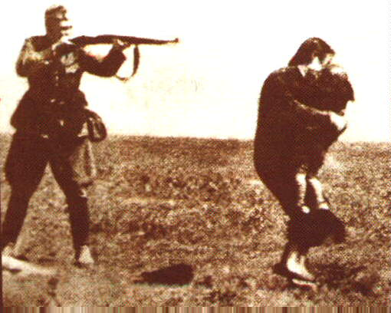
Change of Tactics: Einsatzgruppen

Slide 20
Jewish women, some holding infants, are forced to wait in a line before their execution by Germans and Ukrainian collaborators.
Notes:
MASS EXECUTION USING A FIRING SQUAD WAS COMMON.
THESE WOMEN HAVE BEEN ORDERED TO REMOVE EVERYTHING, CLOTHES, JEWELLERY, EVEN WEDDING RINGS AND ARE BEING FORCED TO LINE UP AND WAIT FOR THEIR TURN TO BE KILLED.
SOME TIME LATER...

Slide 21
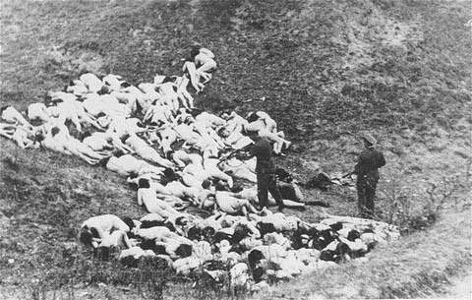
A German policeman shoots individual Jewish women who remain alive in the ravine after the mass execution.
Notes:
THEY HAVE BEEN ORDERED TO LIE, FACE DOWN ON THE GROUND AND HAVE BEEN SHOT.
THE GERMAN POLICEMAN IS SHOOTING INDIVIDUALS WHO HAVE ESCAPED DEATH FROM THE INITIAL ROUND OF BULLETS.
THIS IS HORRIFIC BUT WE CANNOT SEE THE INDIVIDUAL FACES OF THOSE KILLED, WE DON'T REALLY KNOW WHO THEY ARE OR WHAT THEY REALLY LOOKED LIKE.
SO TAKE A LOOK AT THIS NEXT PICTURE...

Slide 22
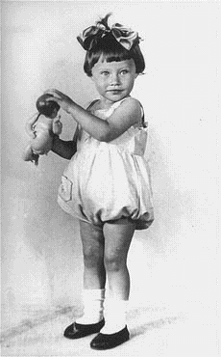
Portrait of two-year-old Mania Halef, a Jewish child who was among the 33,771 persons shot by the SS during the mass executions at Babi Yar, Ukraine, September, 1941.
For details see:
http://www.holocaustresearchproject.org/einsatz/babiyartest.html
Notes:
THIS PICTURE TELLS US A LOT.
HER PARENTS ARE OBVIOUSLY WEALTHY ENOUGH TO HAVE HAD A PORTRAIT DONE, SO IT SHOWS US THAT THE STATUS OF THE JEWS DID NOT MATTER TO THE NAZIS. IT WAS NOT JUST THE POOR WHICH WERE KILLED.
THEY WERE KILLED REGARDLESS OF WEALTH OR STATUS, THEIR DEATH WAS DETERMINED BY RELIGION AND RACE.

Slide 23
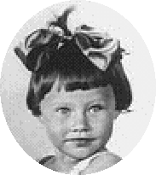
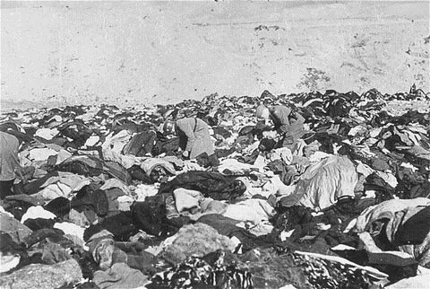
Nazis sift through a huge pile of clothes left by victims of the massacre.
Two year old Mani Halef’s clothes are somewhere amongst these.

Slide 24
Phase 2 = Gas Vans
Again, Jews were rounded up and told they were to be relocated in vans
The vans were equipped so that the van’s exhaust was piped back into the van
700,000 Jews killed in Vans

Slide 25
Problems with Phases 1,2
The Nazis encountered several problems with the executions and gas vans
First, they were both taking to much time
Second, resources such as gas and munitions were becoming scarce
Third, soldiers involved were beginning to have psychological problems with what they were doing.

Slide 26
Phase 3 = The Camps
Nazi leaders decided to drastically speed up the Final Solution
there were two different types of camps:
CONCENTRATION CAMPS
EXTERMINATION CAMPS
Jews from all over occupied Europe were to be brought here.

Slide 27
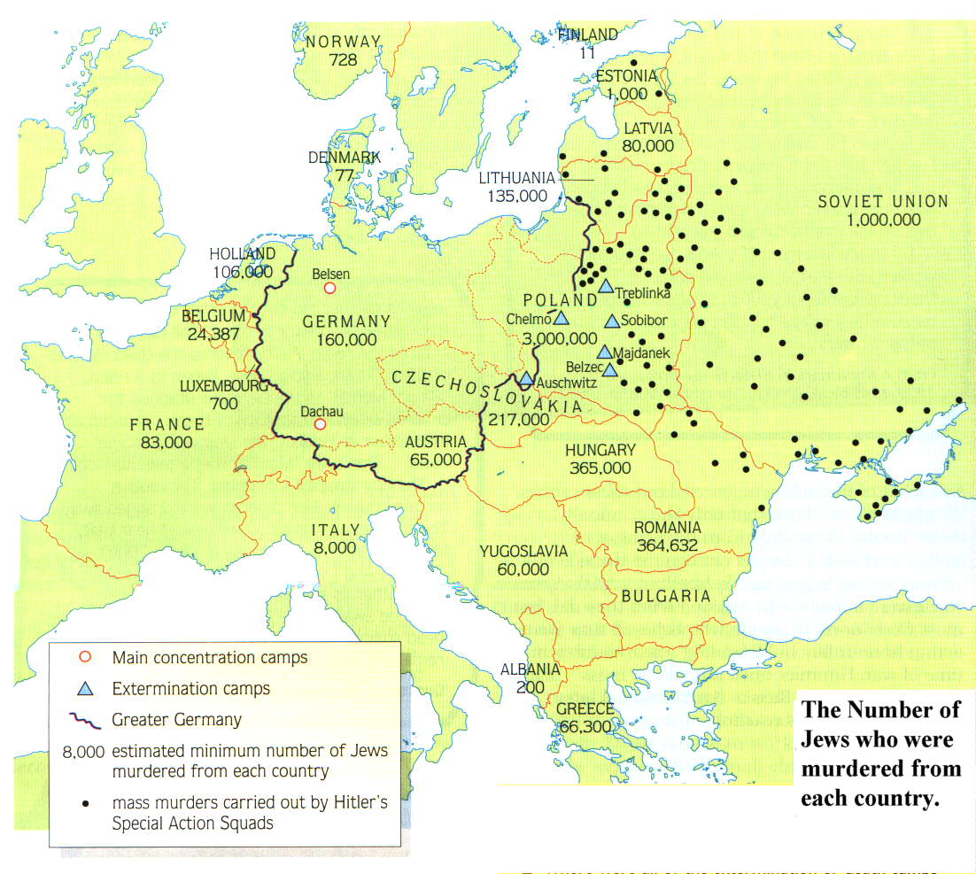
Where were the Death Camps built?
The work of the Einsatzgruppen
Notes:
Remember that the black dots represent the work of the Einsatzgruppen

Slide 28
What tactics did the Nazis use to get the Jews to leave the Ghettos?
Deception
New arrivals at the Death camps were given postcards to send to their friends.
Starvation
The Jews were told that they were going to ‘resettlement areas’ in the East.
The Jews in the Warsaw Ghetto were only fed a 1000 calories a day .
Tactics
In some Ghettos the Jews had to purchase their own train tickets.
A Human being needs 2400 calories a day to maintain their weight
Terror
They were told to bring the tools of their trade and pots and pans.
The SS publicly shot people for smuggling food or for any act of resistance
Hungry people are easier to control

Slide 29
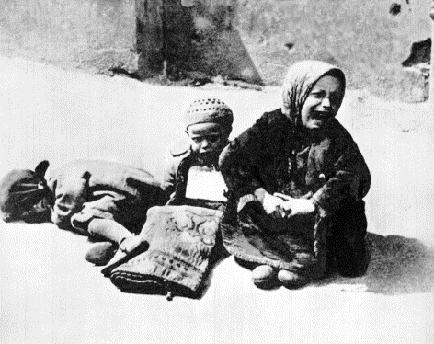
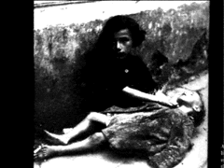
Children Dying of Starvation in the Warsaw Ghetto
Notes:
Evil is when a few good men decide to do nothing. Attributed to Edmund Burke (1729-1797); an Irish political philosopher, Whig politician, and statesman

Slide 30
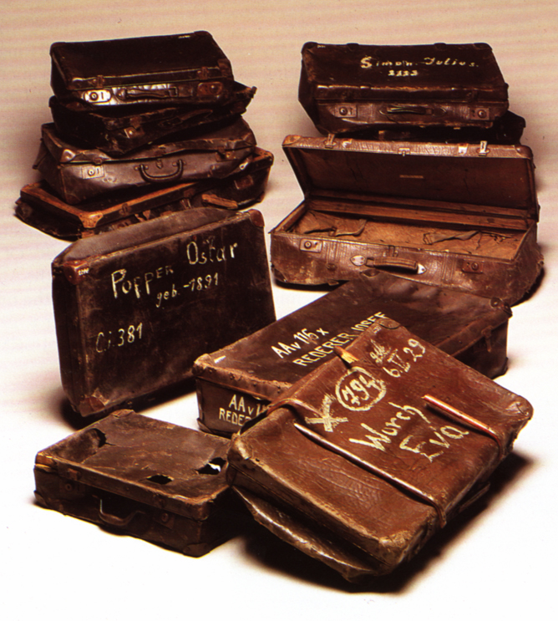
Notes:
Another example of mind games - Each person was allowed to take one suitcase of his or her personal items.
However, the suitcase was promptly taken away at the concentration camp.

Slide 31
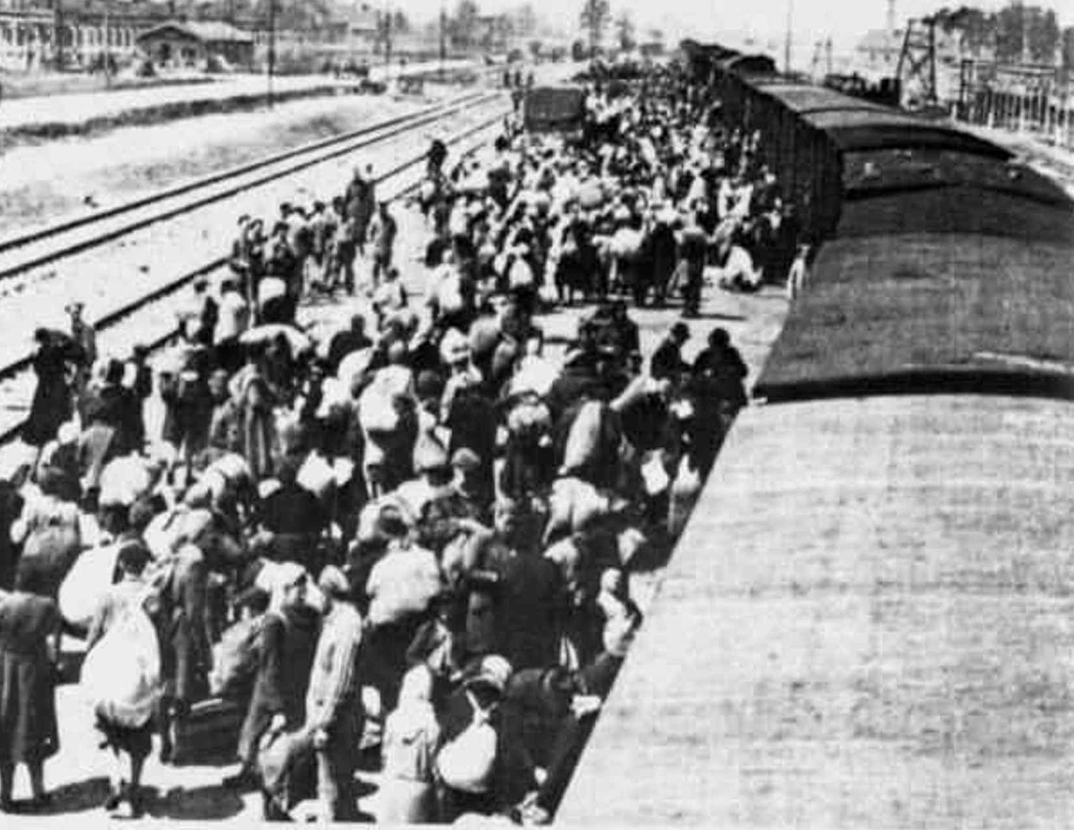
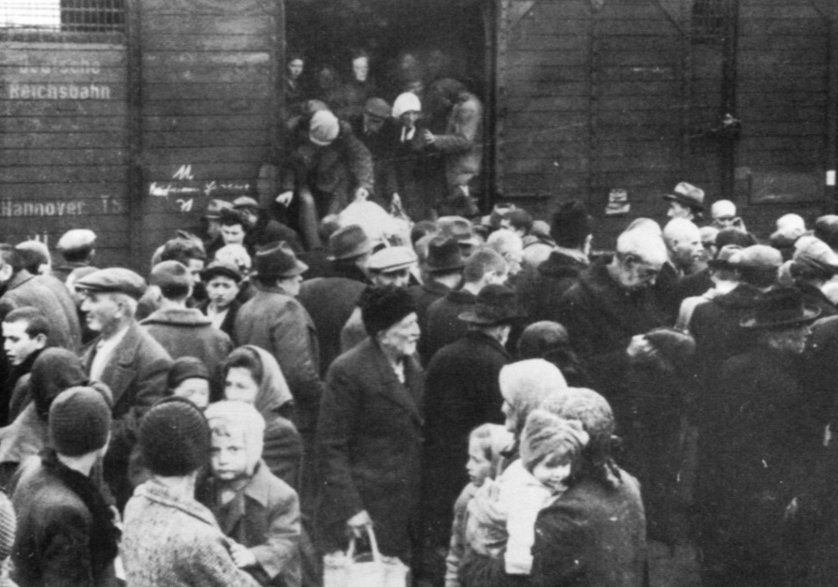
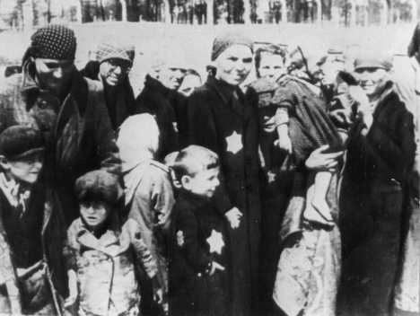
Notes:
Trains used to transport the Jews to the camps.
Boxcars built to hold 8 horses or 40 people were used to transport no fewer than 100 people, often as many as 200 people, were jammed into a boxcar
Crowded conditions – You could not sit down; no food, no water, no lights and no bathrooms. The people who were crushed to death were left on board with the living until the boxcar reached the camp.
The only fresh air came from a small vent at one end of the boxcar or a small window at the other end.
The train rides could last days.
Thousands died - because the people coming from the ghettos were already malnourished or diseased and could not survive the transport.

Slide 32
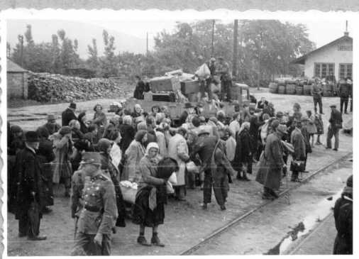
Prisoners arriving at the camps…
Notes:
Trains were greeted by a Nazi commander, who held the power of life or death.
Commanders would instruct the soldiers how to separate people as they were taken off the train.
Suitcases taken away and valuables confiscated.

Slide 33
CONCENTRATION
100 of these in Nazi-occupied Europe
prisoners used for forced labor
prisoners usually lasted less than 1/2 year
communists, homosexuals, criminals, social-democrats, artists.
First camp was opened in 1933, right after Nazis came to power

Slide 34
RAVENSBRUCK
Camp for women only
run by German women who were criminals
prisoners worked on remodeling furs
50,000 killed
14,000 rescued by Swedish diplomat
Count Folke Bernadette negotiating for prisoners

Slide 35
THERESIENSTADT
Most humane camp
well connected Jews and war veterans
Jews married to Aryans could pay to go to this camp
Red Cross inspected this camp, good rating
stop over on the way to Auschwitz
Jewish band playing for Red Cross inspection team

Slide 36
EXTERMINATION
Started out as ordinary concentration camps
later modified with gassing installations for use on humans, now “death camps”
two sub-groups:
1) Majdanek and Auschwitz, Birkenau
2) Operation Reinhard camps and Chelmno

Slide 37
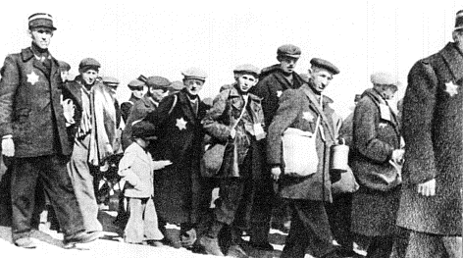
CHELMNO
Jews from the Lodz ghetto in Poland sent here
First death camp built in 1941
First to use Gas Vans on Jews

Slide 38
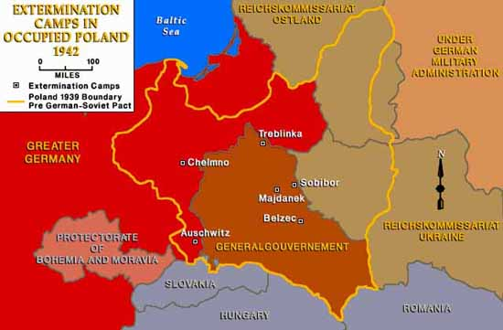
CAMPS IN POLAND

Slide 39
MAJDANEK
Established in 1941 as a POW camp
started its part in the Final Solution in 1942
Jews, Poles and Soviet POW’s sent here
had two gas chambers to exterminate

Slide 40
AUSCHWITZ
Started operations in January 1940 (Poland)
Himmler chose Auschwitz as the place for the Final Solution
had 4 gas chambers/crematories by 1943
mass killings with Zyklon B gas
commanded by Rudolph Hoess
recorded 12,000 kills in one day

Slide 41
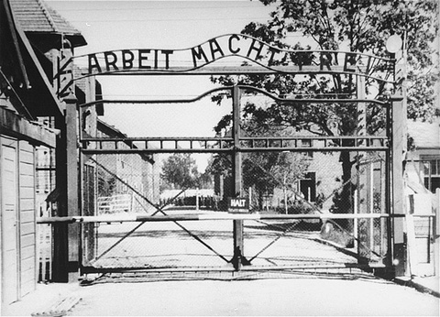
Entrance to Auschwitz
“Work will set you free”
Notes:
Above the gated-entry into the camp was a slogan - "Arbeit Macht Frei" which means "Work will set you free." While the Nazis did use some prisoners as slave laborers, killing was the major goal of this camp. Another mind game example.
Once they were separated by sex, the victims waited in long lines to be checked by a doctor. He decided who would go to the gas chambers.
Old people, sick people, women with children under 14, and all pregnant women were told to remove their clothing and then they were led to the shower rooms which were actually the gassing chambers. Guards threw canisters into the "showers" which exploded. At the end of 15 minutes, if the guard saw no one standing, doors were opened, bodies removed and an exhaust fan cleaned the bad air before the next group of people were brought in.
Before the bodies were taken to the crematorium, a person's head was shaved and all dental work was removed. Then the bodies were placed in the ovens to burn.

Slide 42
Tactics: What happened to new arrivals?
All new arrivals went through a process known as ‘selection.’
At Auschwitz the trains pulled into a mock up of a normal station.
Mothers, children, the old & sick were sent straight to the ‘showers’ which were really the gas chambers.
The Jews were helped off the cattle trucks by Jews who were specially selected to help the Nazis
Deception & Selection
The able bodied were sent to work camp were they were killed through a process known as ‘destruction through work.’
At some death camps the Nazis would play records of classical music to help calm down the new arrivals.
At Auschwitz the new arrivals were calmed down by a Jewish orchestra playing classical music.

Slide 43
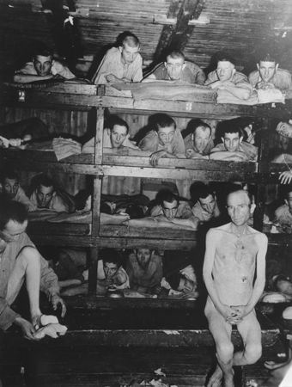
Crowded Conditions
Notes:
The young, the healthy, and those with skills needed by camp officials were sent to a camp. In the camp, their heads were shaved and they were herded into overcrowded barracks. They were assigned a number and a uniform that looked like a black and white striped pajama. In Auschwitz, a number was tattooed on the prisoner's forearm. Men and women were assigned to different barracks. Everyone had a job.
Many prisoners were assigned jobs in factories built near the camps. The factories produced items essential for the war effort. Hair that was shaved from victims was used to stuff mattresses or pillows; gold removed from both living and dead prisoners was melted into bricks; any other metal was sent to the factory to be made into bullets.
Camp rules were strict - a prisoner has to obey or he was punished or killed. Many times the guards were sadistic - they could punish a prisoner any way they chose and nobody cared. When prisoners were fed, they were given bread made from sawdust and one bowl of vegetable broth made from rotten vegetables.
All punishments were cruel and inhumane. Some prisoners were whipped, others were hung by their arms and left for long periods of time.

Slide 44
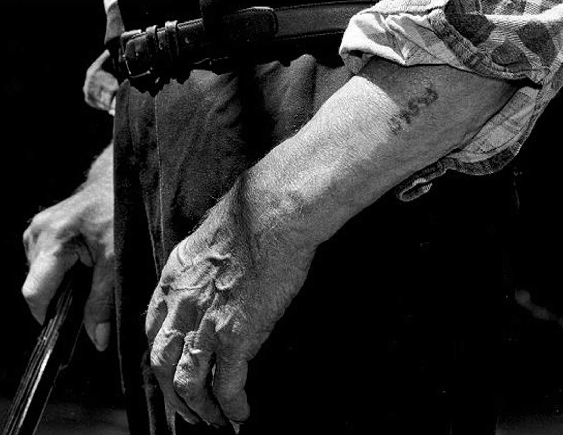
Notes:
This is a photo of a survivor, showing the tattoo with which he received while at Auschwitz.

Slide 45
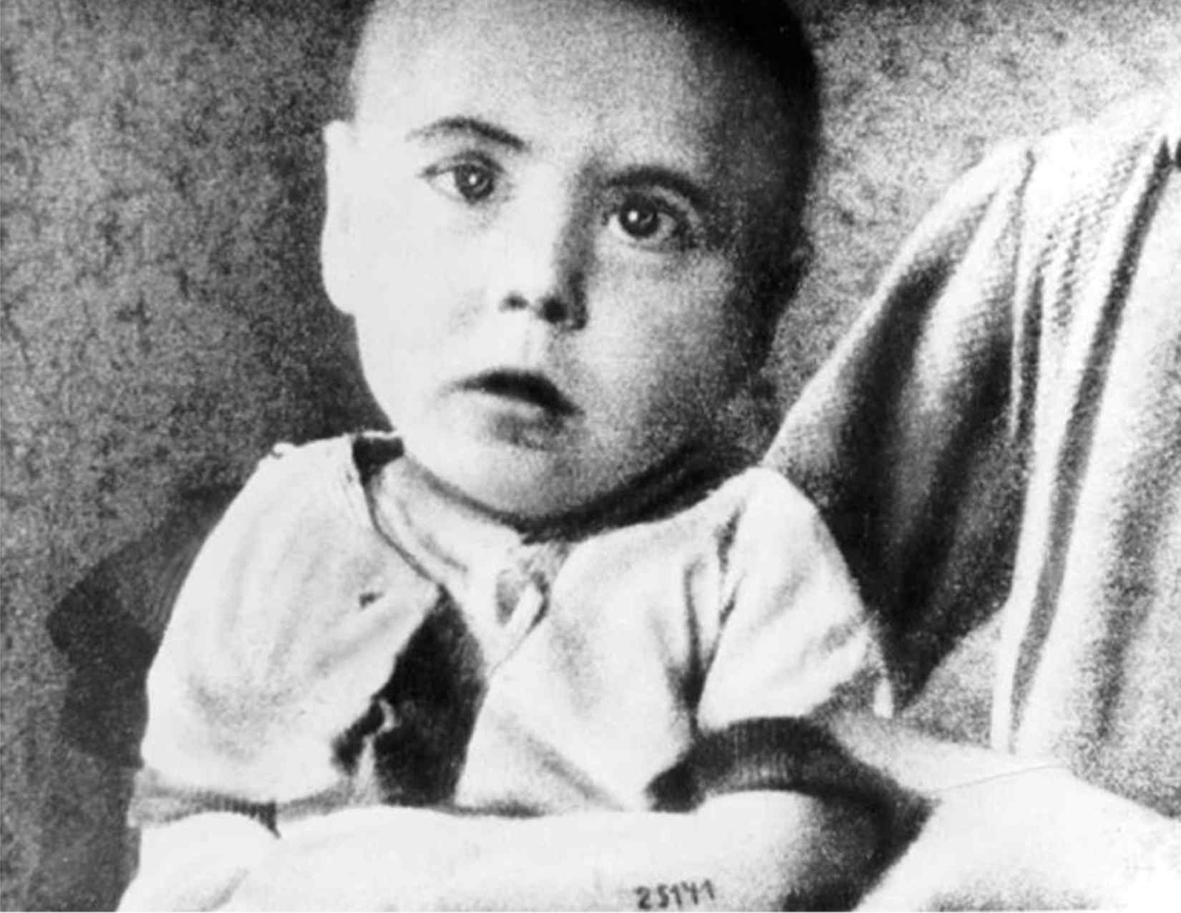
Even the very young…
Notes:
Because most children were immediately killed, it is likely this baby was part of a study that used twins for experiments preformed by Nazi doctors.

Slide 46
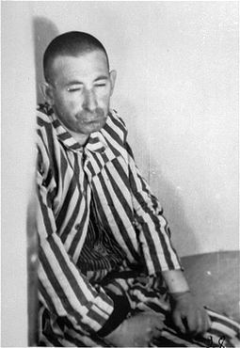
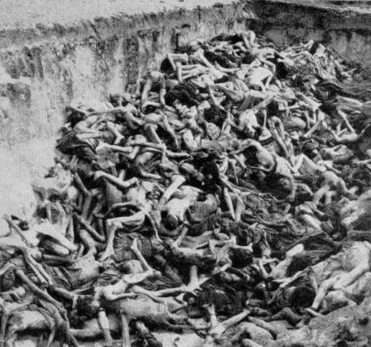
Photo credit: German National Archives
Notes:
Scores of Nazi doctors and medical researchers were given permission to carry out medical experiments on people in the camp where specially equipped laboratories were built.
Dr. Josef Mengele, "Angel of Death," was in charge of the staff, which performed the medical experiments in the name of “scientific research”. The experiments were a form of torture because none were done using anesthesia.
Children as well as adults were used in experiments.
People were injected with terrible diseases; organs were removed, and some experiments were done for specific reasons. For example, men were placed in cold water to see how long they could live before they succumbed to hypothermia. This experiment provided the Nazis with a time limit on how long their pilots could survive in water if they were shot down over the Baltic or North Sea.
Every experiment was documented.

Slide 47
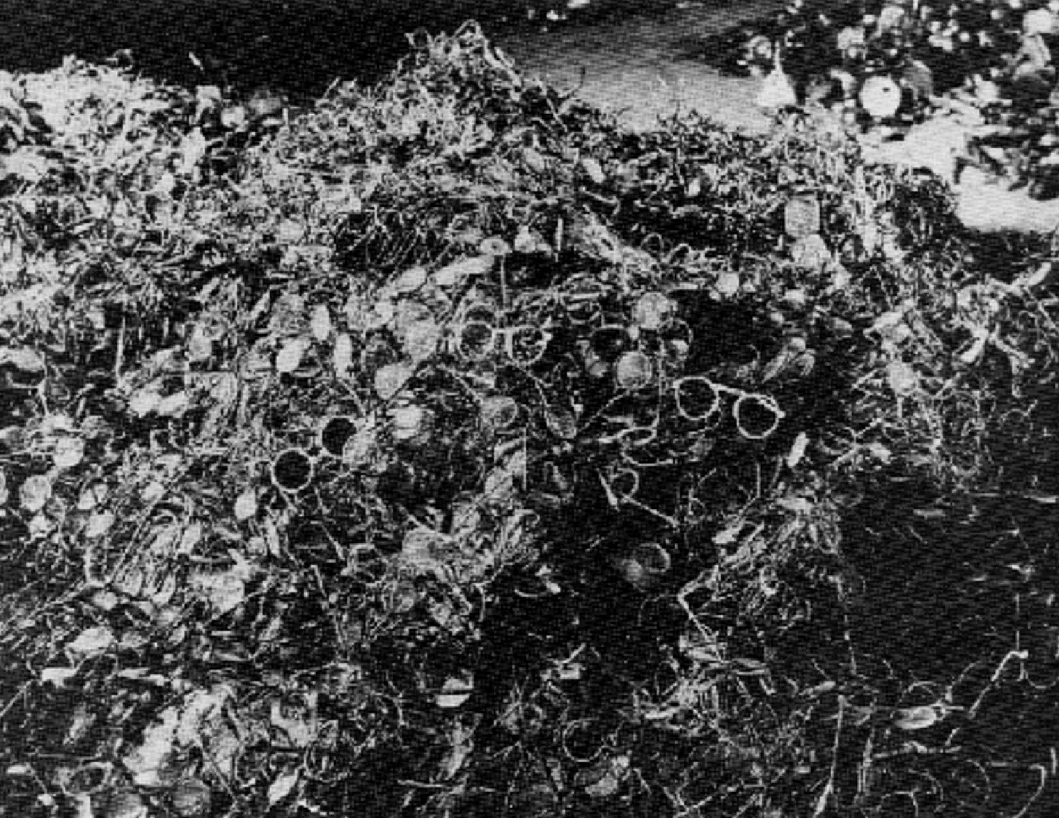
eyeglasses
Notes:
When the prisoners were stripped of their clothing, nothing was wasted.
This is a pile of eyeglasses - Note the mass amount – thousands were killed daily.

Slide 48
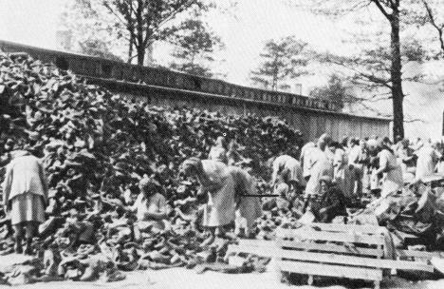
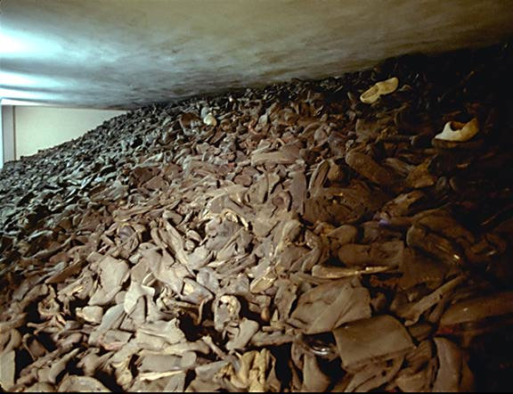
Shoes

Slide 49
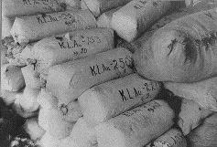
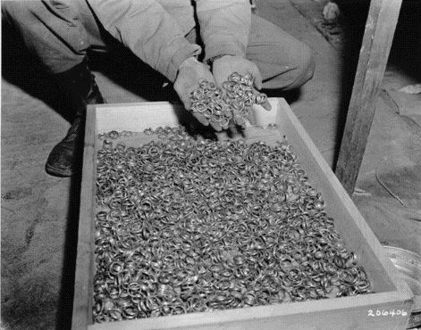
Bales of hair shaven from women at Auschwitz, used to make felt-yarn.
After liberation, an Allied soldier displays a stash of gold wedding rings taken from victims at Buchenwald.

Slide 50
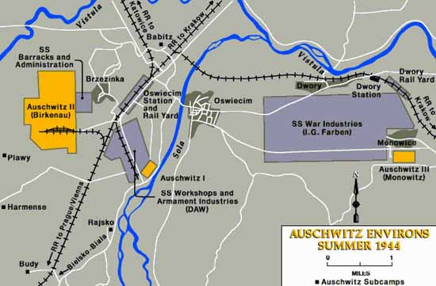
Map of Auschwitz
New Arrivals
‘Showers’
‘Destruction Through Work’

Slide 51
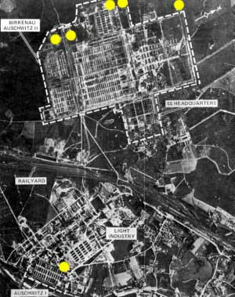
Auschwitz from the air
The Nazis used industrial methods to murder the Jews and process their dead bodies
Notes:
It is important to emphasis that the Death Camps were basically factories

Slide 52
The Gas Chambers
The Nazis would force large groups of prisoners into small cement rooms and drop canisters of Zyklon B, or prussic acid, in its crystal form through small holes in the roof.
These gas chambers were sometimes disguised as showers or bathing houses.
The SS would try and pack up to 2000 people into this gas chamber

Slide 53
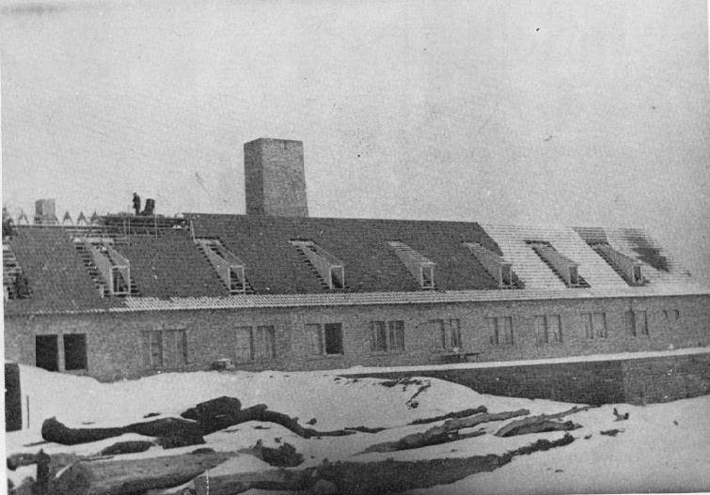
The outside of the Gas Chamber
Notice the Ovens easy located near the Gas Chambers

Slide 54
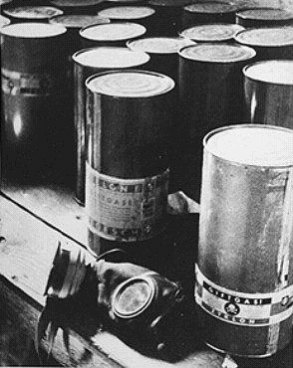
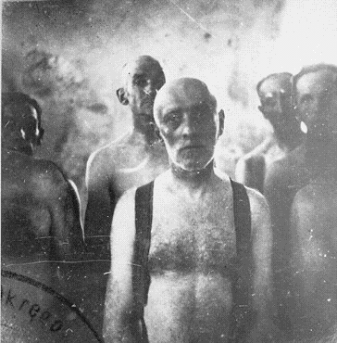
Part of a stockpile of Zyklon-B poison gas pellets found at Majdanek death camp.
Before poison gas was used , Jews were gassed in mobile gas vans. Carbon monoxide gas from the engine’s exhaust was fed into the sealed rear compartment. Victims were dead by the time they reached the burial site.
Notes:
THIS IS THE GAS THAT WAS INTRODUCED IN 1942.
JEWS WERE SENT INTO SEALED SHOWER UNITS ON THE PRETENCE THAT THEY WERE GOING TO BE SHOWERED. PELLETS WERE THEN PLACED INTO THE SHOWER HEADS AND GAS CAME FROM THE SHOWERS INSTEAD OF WATER.
15 MINUTES LATER THE SHOWER ROOM WOULD BE EMPTIED, BODIES WERE ALWAYS IN A PYRAMID SHAPE, PEOPLE TRIED TO CLIMB ON TOP OF ONE ANOTHER TO ESCAPE THE GAS.
BEFORE THIS TYPE OF KILLING METHOD WAS INTRODUCED THOUGH A MORE PRIMITIVE GASSING METHOD WAS USED....
I DON'T KNOW HOW, OR EVEN WHY THIS PHOTO WAS TAKEN, BUT IT SHOWS SOME MEN AWAITING DEATH ON THEIR WAY TO THEIR BURIAL PLACE.
DID THEY ALWAYS BURY THE DEAD?

Slide 55
Processing the bodies
Specially selected Jews known as the sonderkommando were used to to remove the gold fillings and hair of people who had been gassed.
The Sonderkommando Jews were also forced to feed the dead bodies into the crematorium.

Slide 56
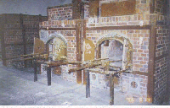
The Ovens at Dachau

Slide 57
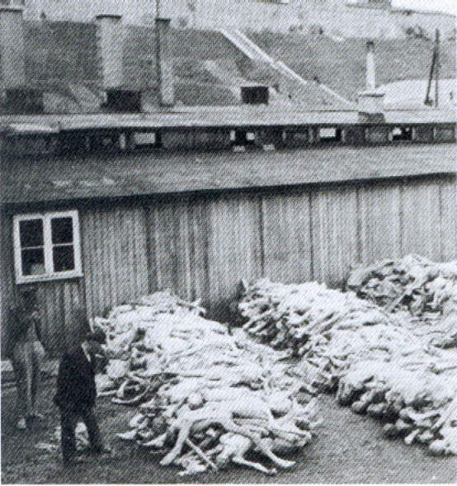
Dead bodies waiting to be processed

Slide 58
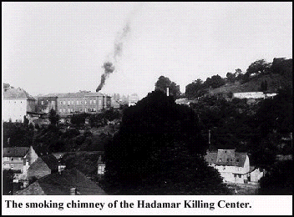
Smoke rises as the bodies are burnt.

Slide 59
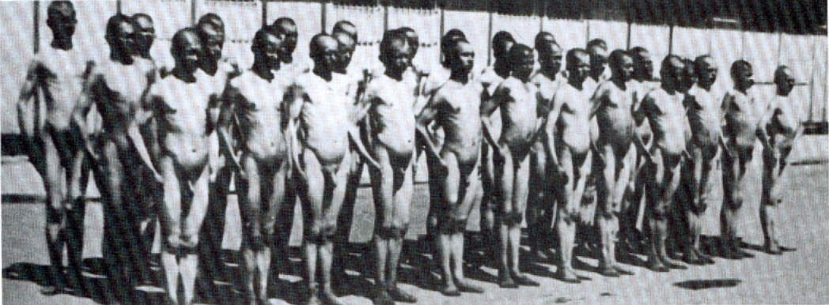
Destruction Through Work
This photo was taken by the Nazis to show just how you could quite literally work the fat of the Jews by feeding them 200 calories a day…

Slide 60
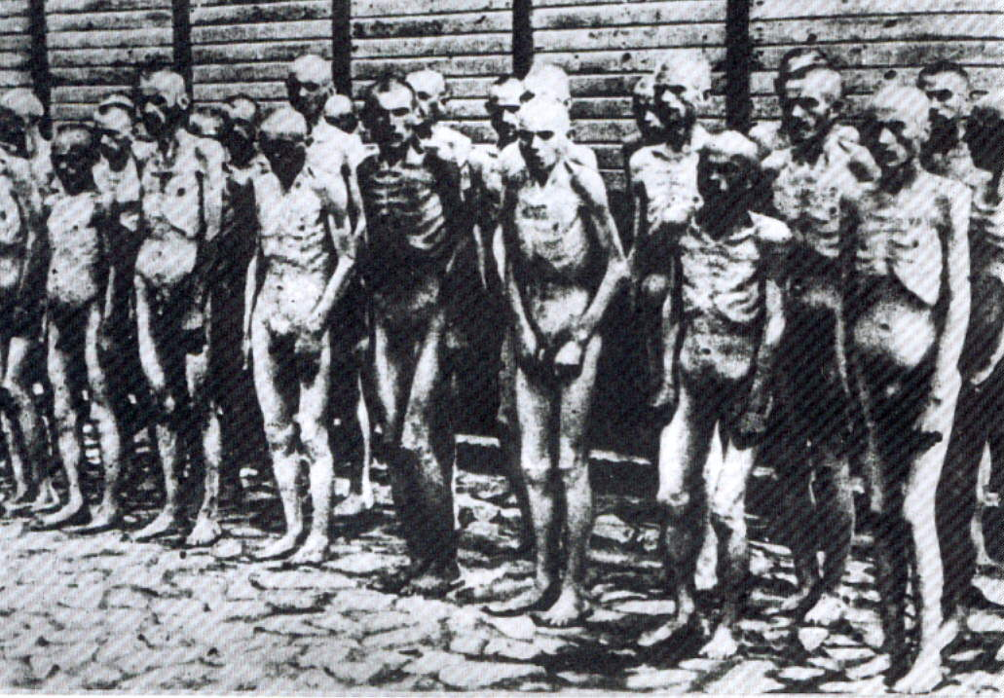
Destruction Through Work
Same group of Jews 6 weeks later

Slide 61
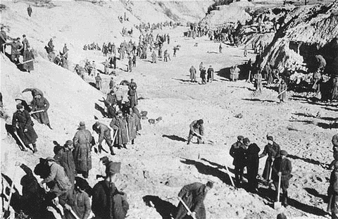
In 1943, when the number of murdered Jews exceeded 1 million. Nazis ordered the bodies of those buried to be dug up and burned to destroy all traces.
Soviet POWs at forced labor in 1943 exhuming bodies in the ravine at Babi Yar, where the Nazis had murdered over 33,000 Jews in September of 1941.

Slide 62
Dr. Josef Mengele
Arrived in Auschwitz in May of 1943
SS Doctor who had power of life/death
performed medical experiments on Jewish children
“ANGEL OF DEATH”

Slide 63
MEDICAL EXPERIMENTS
Sterilization of men and women
endurance of pain to high and low temperatures and pressure
experiments on twins to increase number of multiple births to Aryan women
injections of phenol to kill patients
Dr. Mengele attempted to sew children together to make Siamese twins

Slide 64
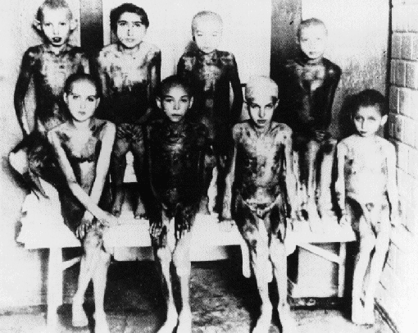
MEDICAL EXPERIMENTS
EXTRACTED HUMAN ORGANS
EXPERIMENTS ON CHILDREN IN AUSCHWITZ

Slide 65
OPERATION REINHARD
Largest single massacre of Holocaust
March 1942-November 1943
named after Reinhard Heydrich
carried out at Belzec, Sobibor and Treblinka
every Jew that arrived at one of the camps would be dead in 2 hours.
Total of 1,700,000 Jews killed
http://www.jewishvirtuallibrary.org/jsource/Holocaust/reinhard.html

Slide 66
BELZEC
MARCH 1942
JEWS FROM LUBIN GHETTO- POLAND
OPERATIONS STOP DECEMBER 1942
CAMP WAS DISMANTLED AND PLOWED OVER AND PLANTED ON

Slide 67
SOBIBOR
MAY 1942
3 GAS CHAMBERS
ESCAPE OF 300 JEWS AND SOVIET POW’S
ONLY 50 LIVE
GAS CHAMBERS SHUT DOWN AFTER ESCAPE

Slide 68
TREBLINKA
JEWS FROM WARSAW GHETTO
10 GAS CHAMBERS
LOCATED EAST OF WARSAW
BODIES WERE BURNED IN OPEN PITS
AUGUST 1943

Slide 69
Percentage of Jews killed in each country
POLAND 91%
AUSTRIA 35%
USSR 36%
BELGIUM 45%
NORWAY 45%
LUXEMBOURG 55%
ROMANIA 84%
ESTONIA 44%
A Total of 6,000,000 Jews
HUNGARY 74%
BOHEMIA 60%
YUGOSLAVIA 81%
LATVIA 84%
NETHERLANDS 71%
LITHUANIA 85%
GERMANY 36%
FRANCE 22%
GREECE 87%
Notes:
How did they manage to get together all these Jews to kills them?
How did they kill them when they had them?
To begin with there were concentration camps.

Slide 70
Was the Final Solution successful?
The Nazis aimed to kill 11 million Jews at the Wannsee Conference in 1941
Today there are only 2000 Jews living in Poland.
The Nazis managed to kill at least 6 million Jews.
Men like Schindler helped Jews escape the Final Solution.
Not all Jews went quietly into the gas cambers.
In 1943, the Warsaw Ghetto, like many others revolted against the Nazis when the Jews realised what was really happening.

Slide 71
“In Germany they first came for the Communists, and I didn’t speak up because I wasn’t a Communist. Then they came for the Jews, and I didn’t speak up because I wasn’t a Jew. Then they came for the trade unionists, and I didn’t speak up because I wasn’t a trade unionist. Then they came for the Catholics, and I didn’t speak up because I was a Protestant. Then they came for me – and by that time no one was left to speak up.”
Reverend Martin Niemoeller,
Protestant minister, Germany, and concentration camp survivor
Notes:
SLIDE 47 – Poem

