Slide 1
French Revolution bingo
Write down four things you associate with the French Revolution

Slide 2
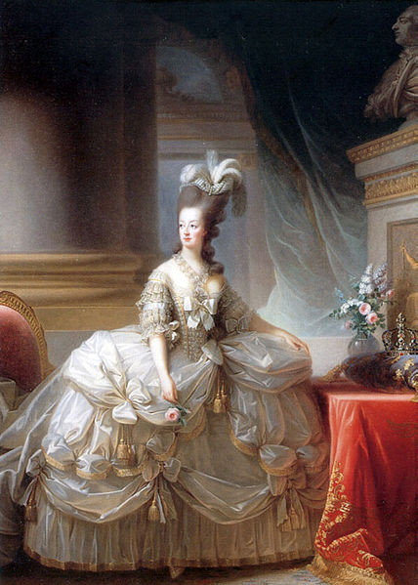
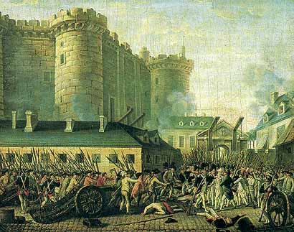
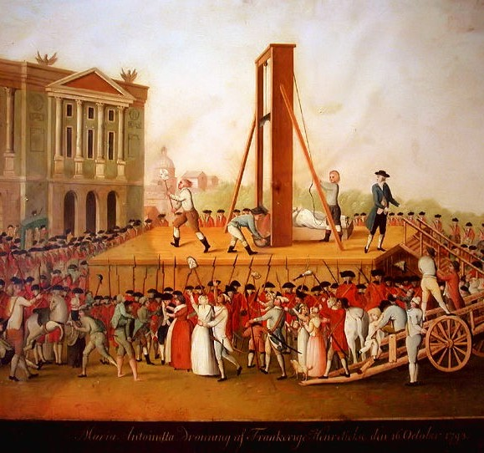
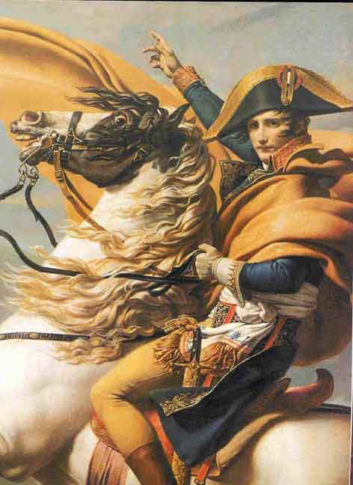
Banning of trade unions
Invention of chips
Declaration of the Rights of Man and Citizen
Marie Antoinette
Storming of the Bastille
Guillotine
and Terror
Napoleon Bonaparte

